Slide 1
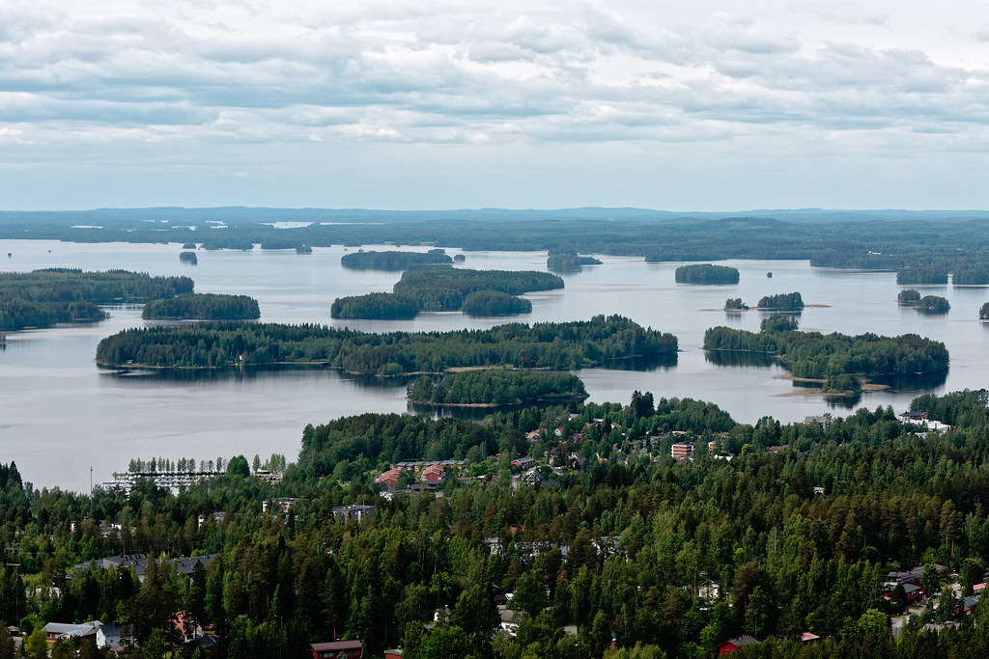
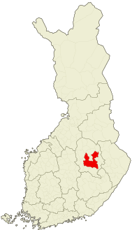
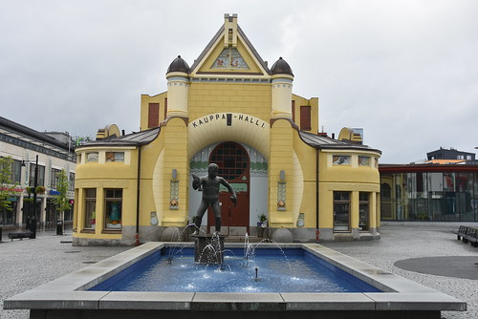
KUOPIO, FINLAND 123 000 inhabitants surface area 4 326,35 km², whereof 1 085,30 km² is waters

Slide 2
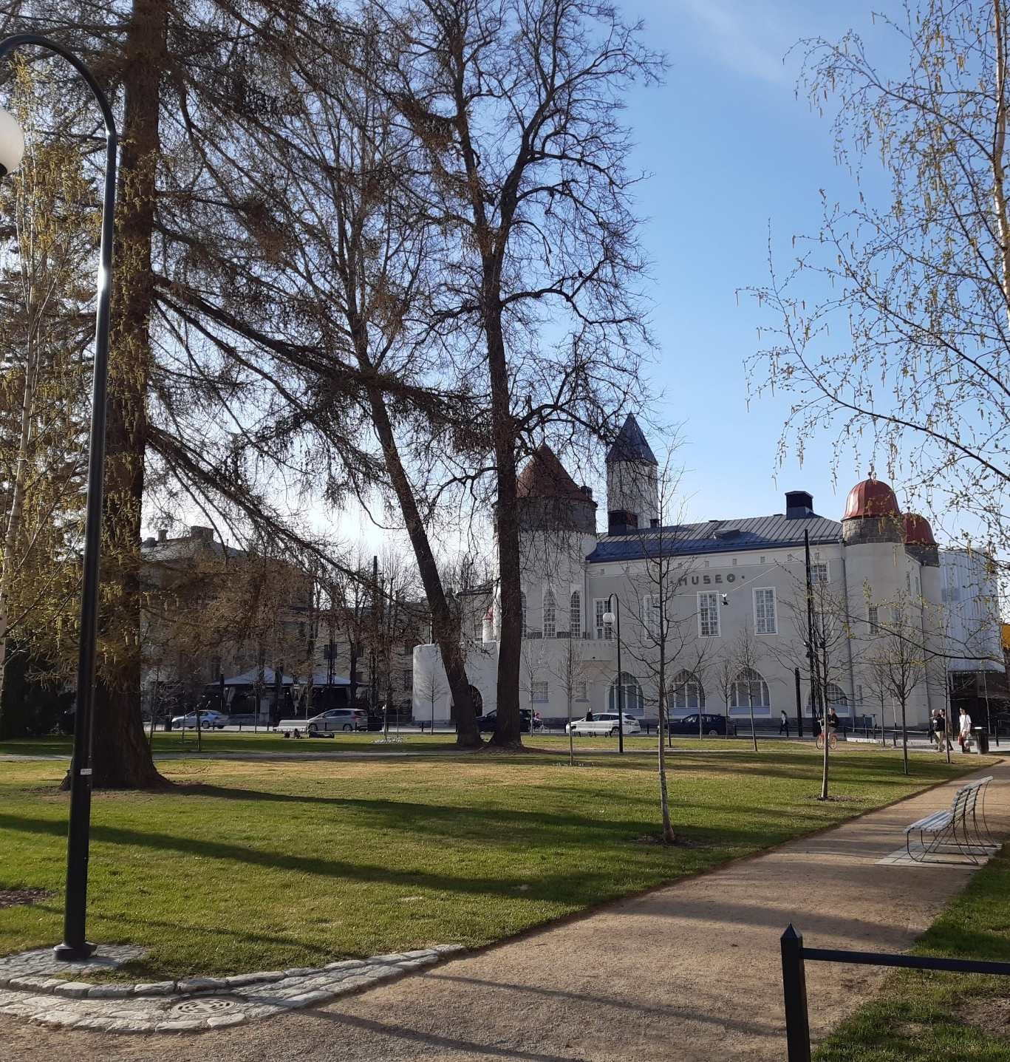
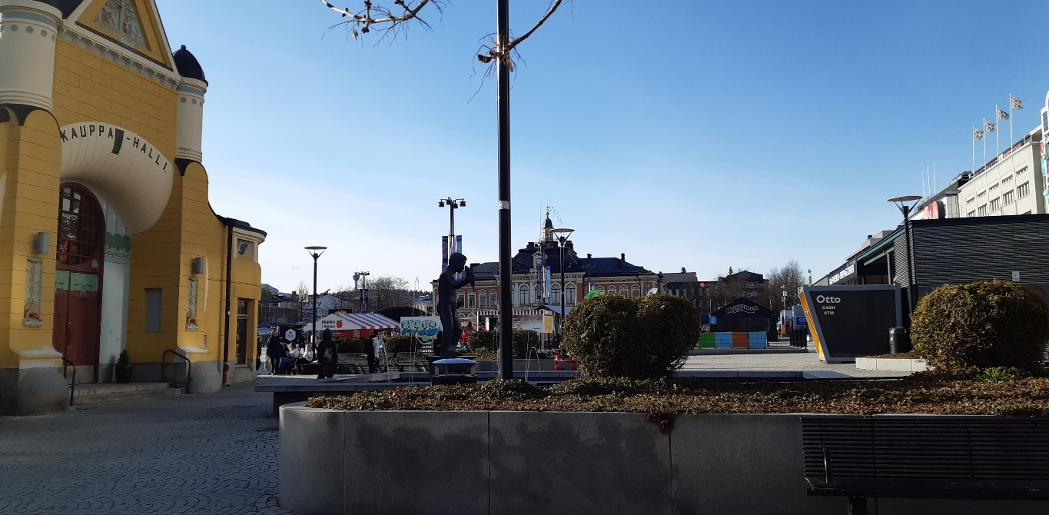

Slide 3
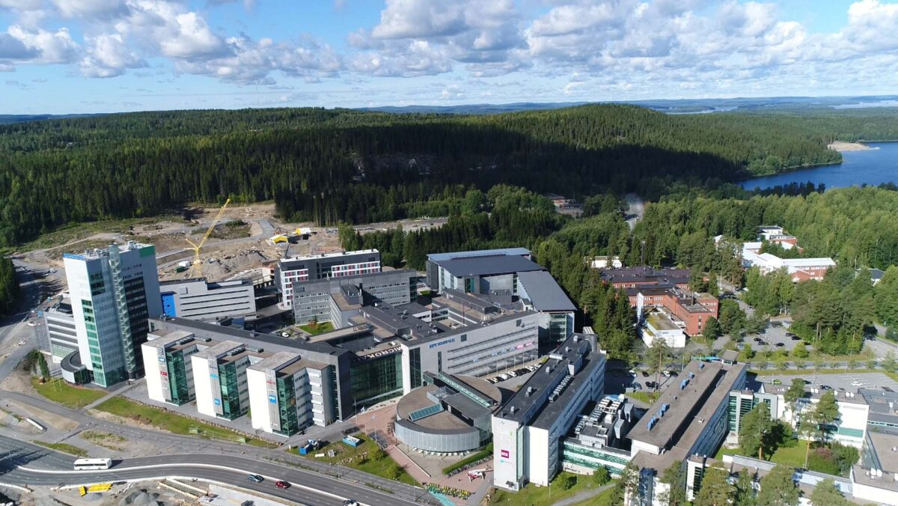
Campuses in three cities;
Iisalmi, Kuopio and Varkaus
Over 7000 students
SAVONIA

Slide 4
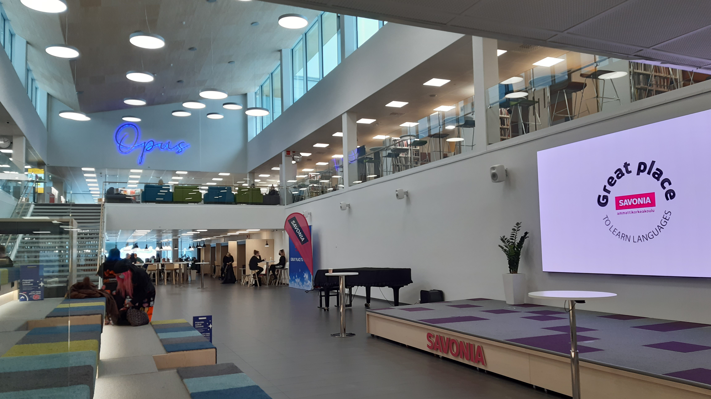

Slide 5
Physiotherapy studies

Slide 6
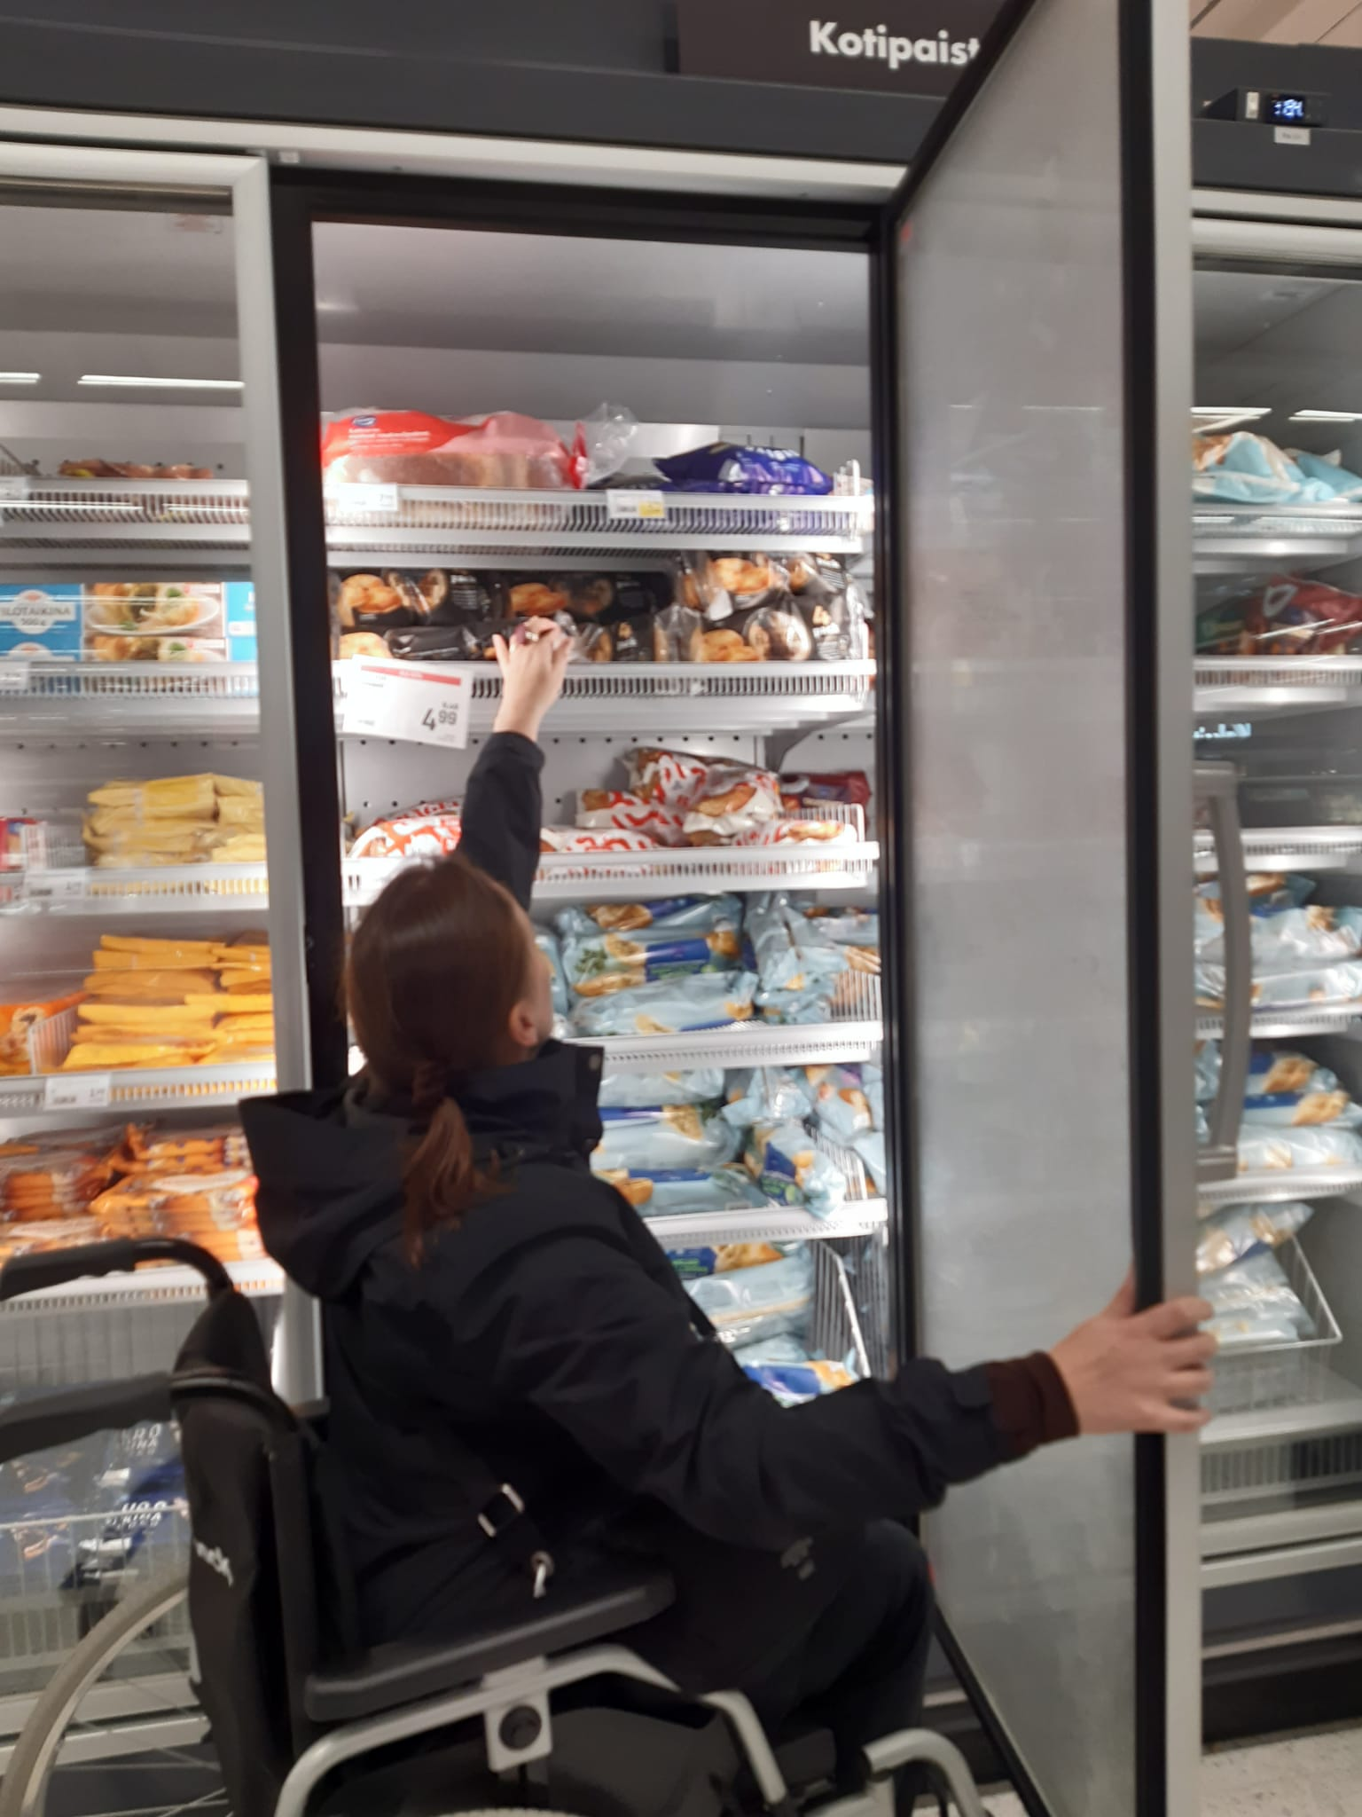
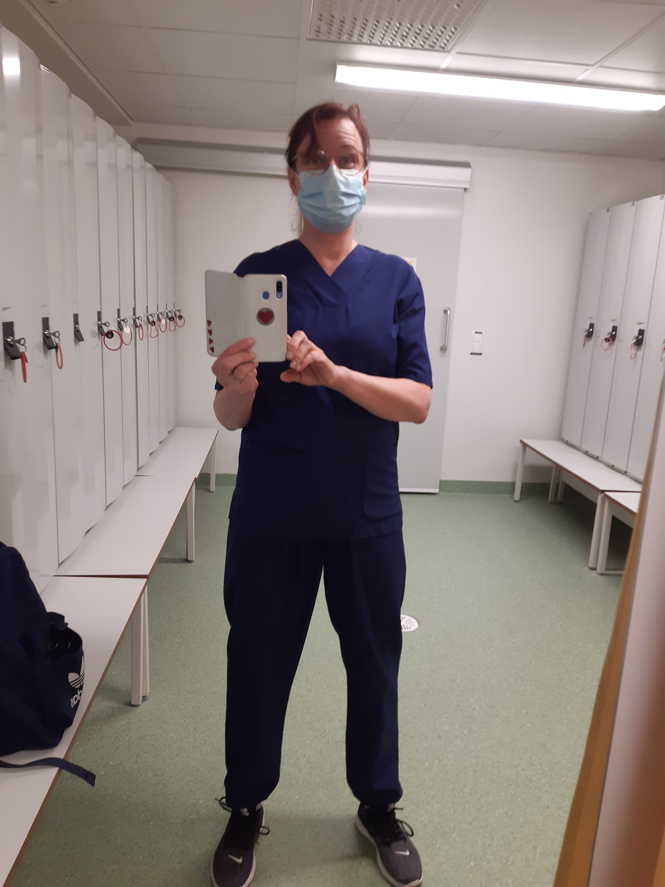
Bachelor´s degree in 3,5 years
210 credits
56,5 credits in internships
A lot of student activities
Campusonline

Slide 7
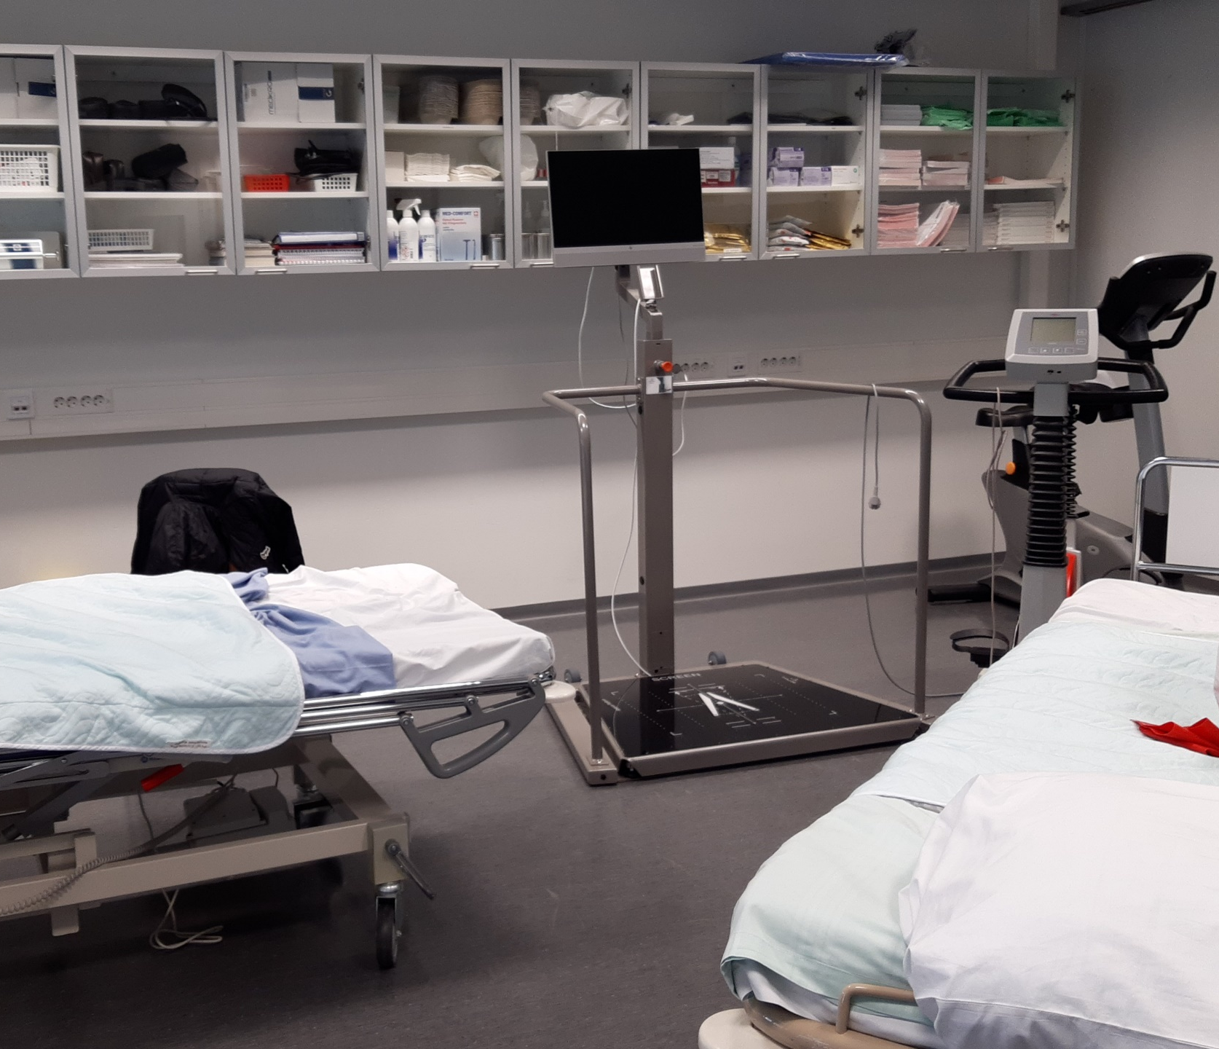
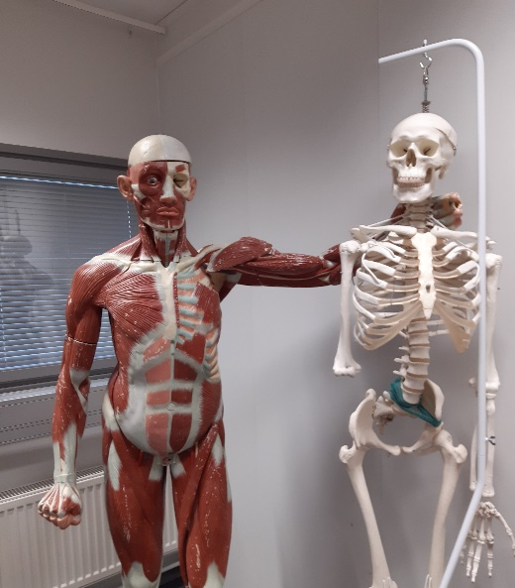
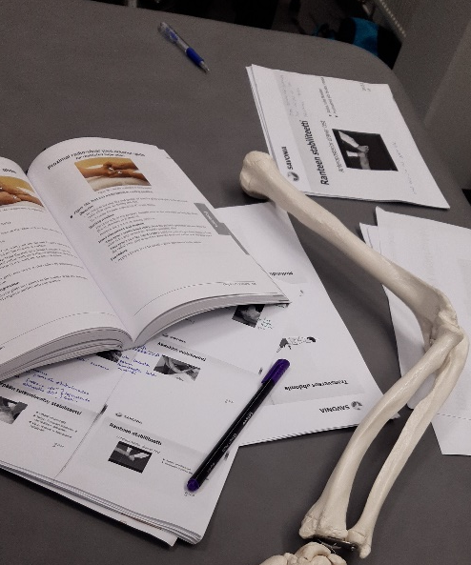

Slide 8
Thank you

