Slide 1
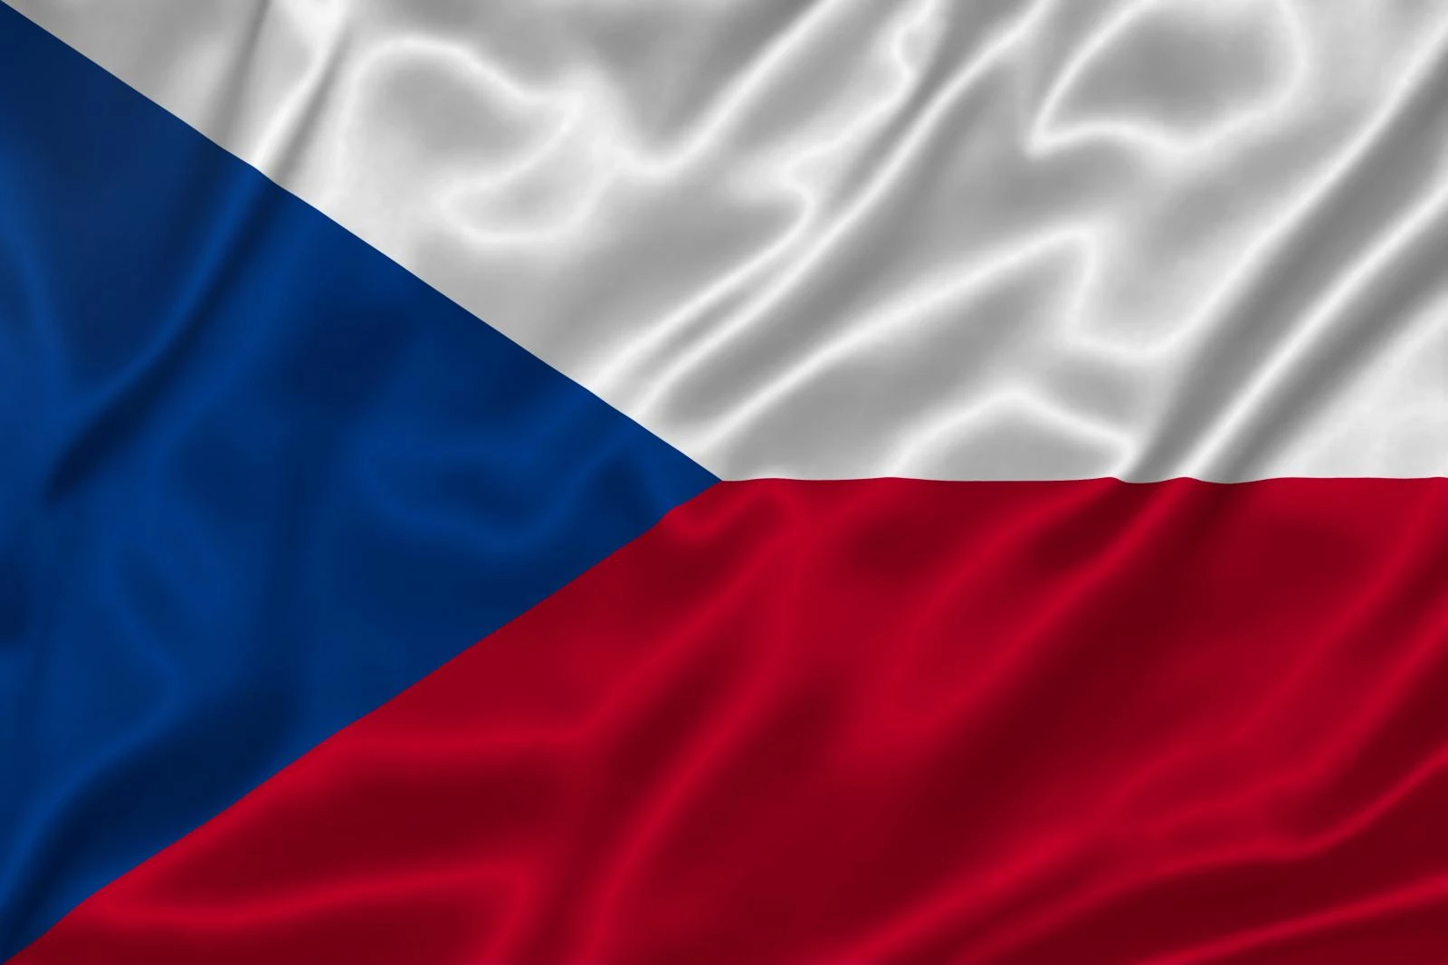
Czech Republic & Charles university Third Faculty of Medicine

Slide 2
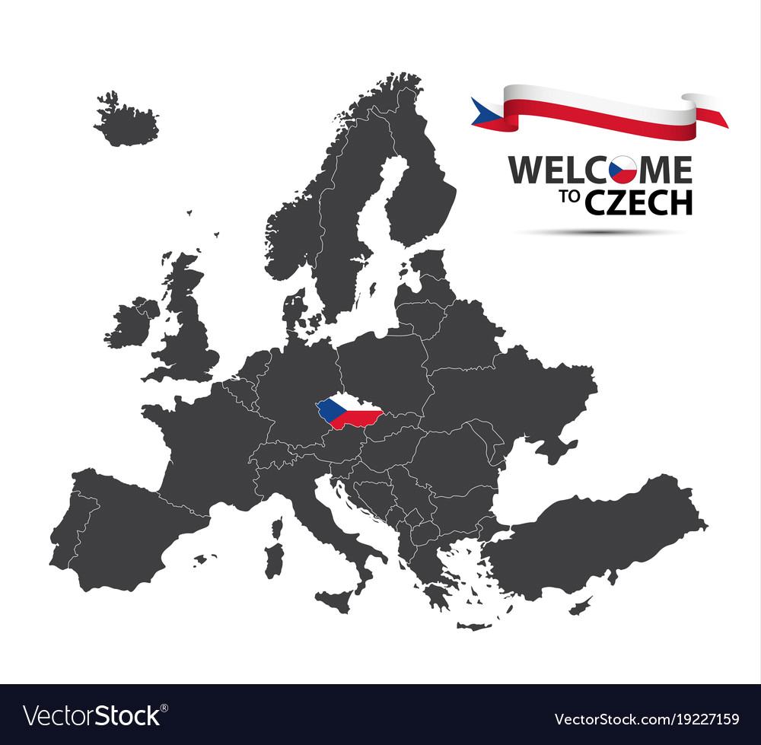
Basic info about Czech Republic
Location: Central Europe
Area: 78, 871 sq. km.
Population: approx. 10 900 555
Climate: continental, 4 seasons
The highest peak: Sněžka (1603 m.)
The longest river: Vltava
Government: unitary parliamentary republic
Notes:
Czech republic or also commonly used Czechia is our landlocked country located in Central Europe bordered by Germany (to the west), Poland (to the northeast), Slovakia (to the southeast) and Austria (to the south).

Slide 3
What comes to your mind

Slide 4
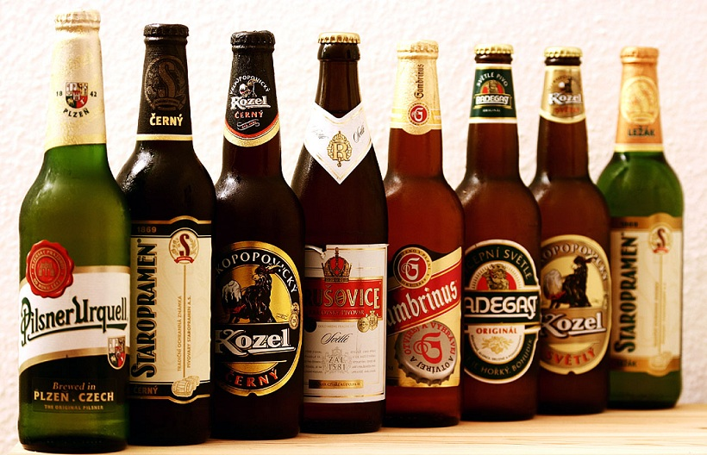

Slide 5
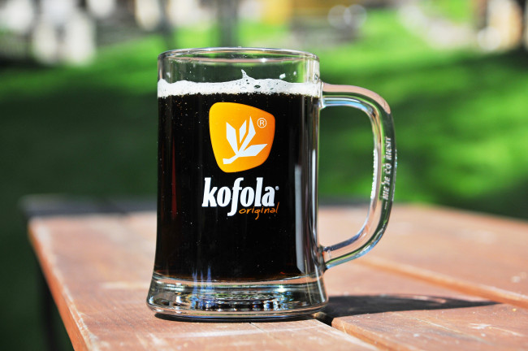
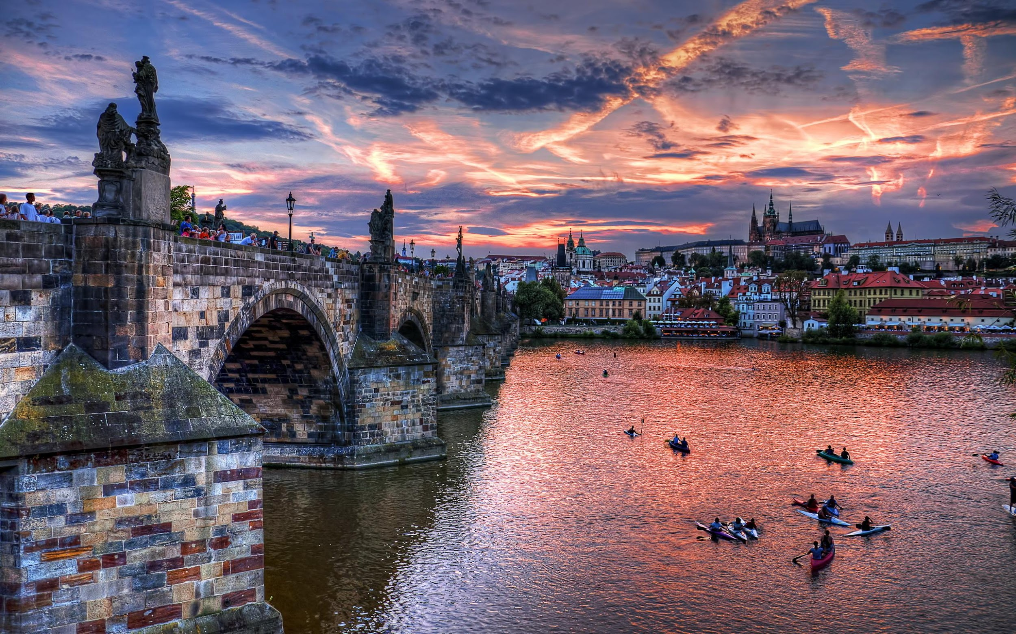
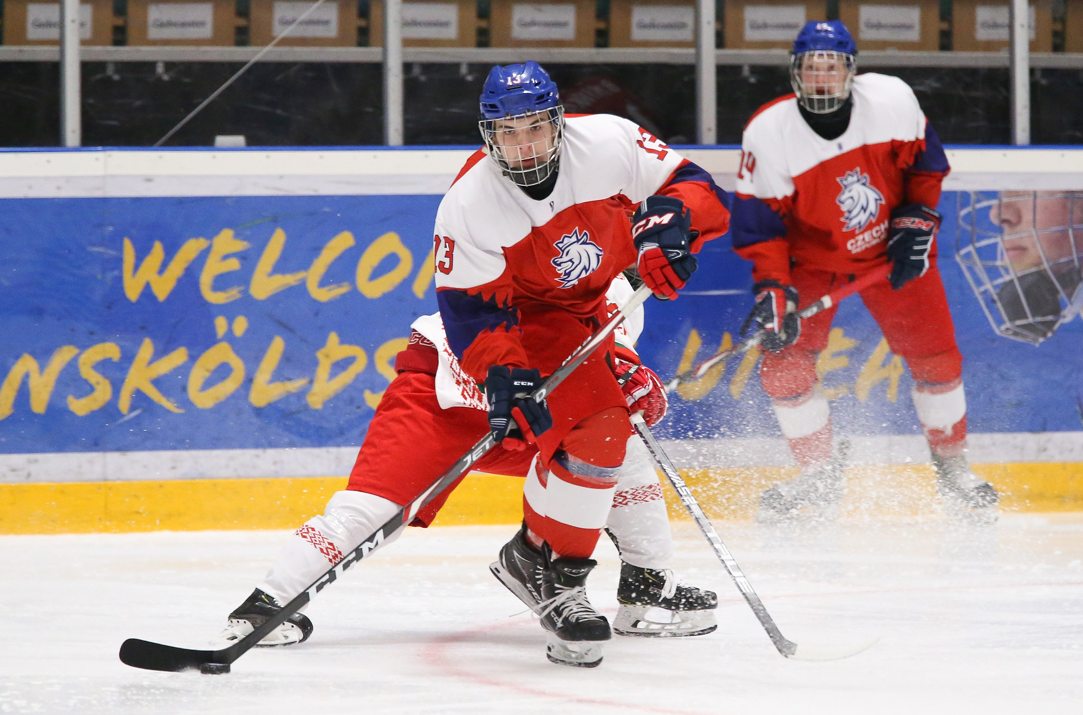
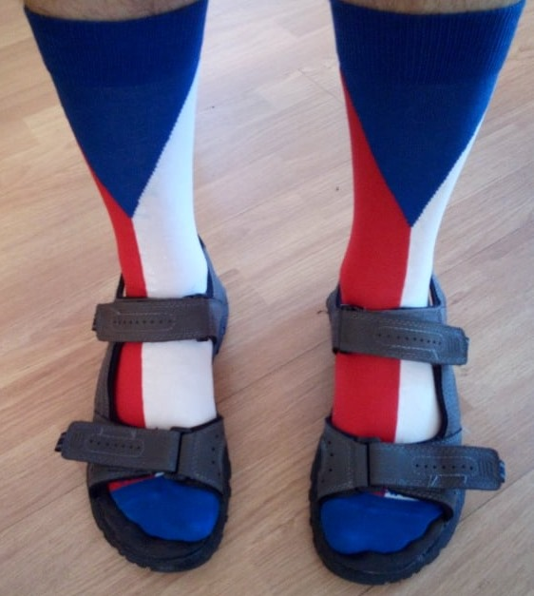
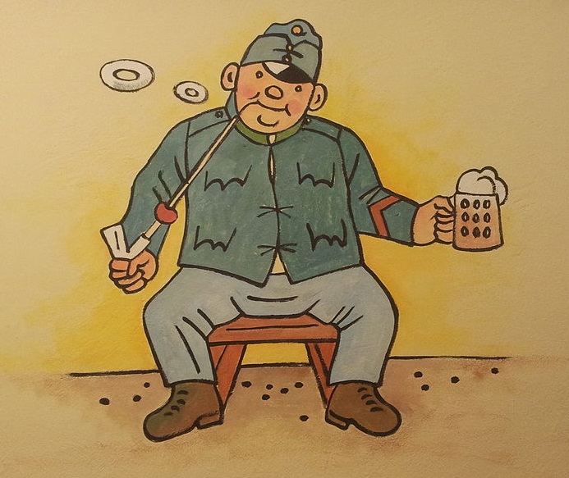
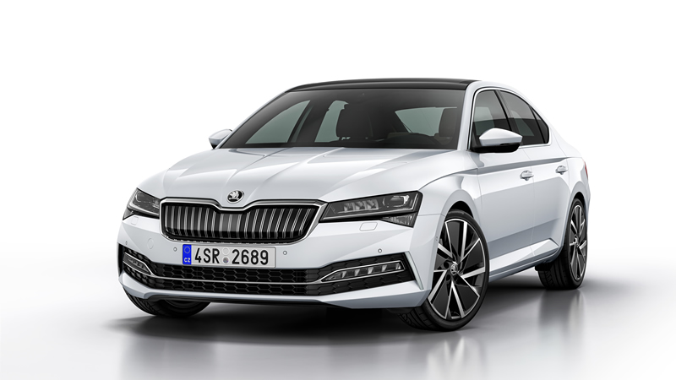

Slide 6
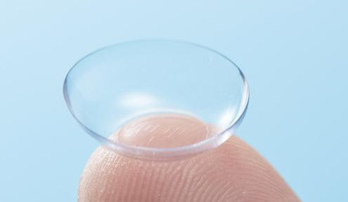
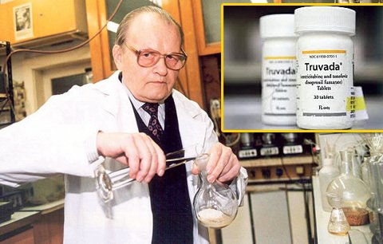
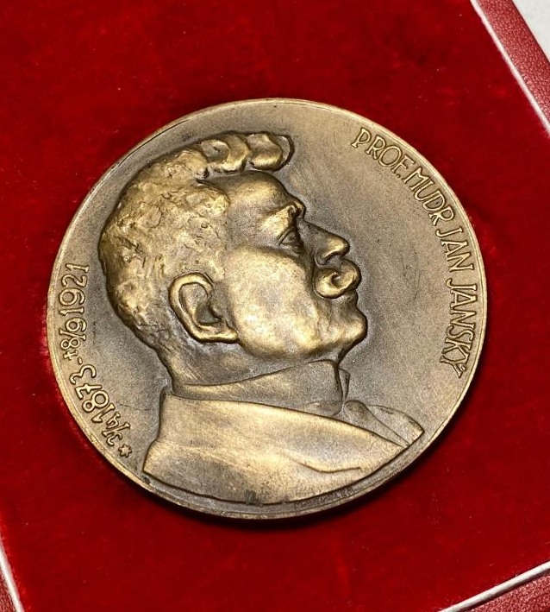
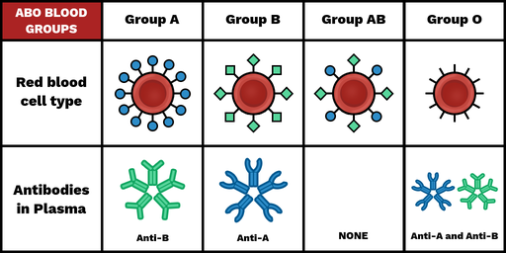
Czech inventions in medicine
Contact lenses (Otto Wichterle)
Classification of blood types (Jan Jánský)
Nanofibers (Liberec) -> artificial blood vessels
Truvada (cure for AIDS – Antonín Holý)
Notes:
Classification of blood types (four groups by Jan Jánský - psychiatr)
Speciální ocenění dárcům krve na počest Jana Jánského
Contact lenses by Otto Wichterle + taky SILONKY

Slide 7
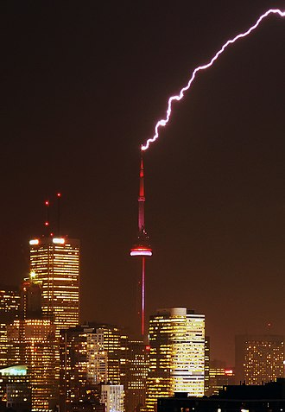
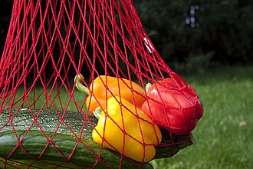
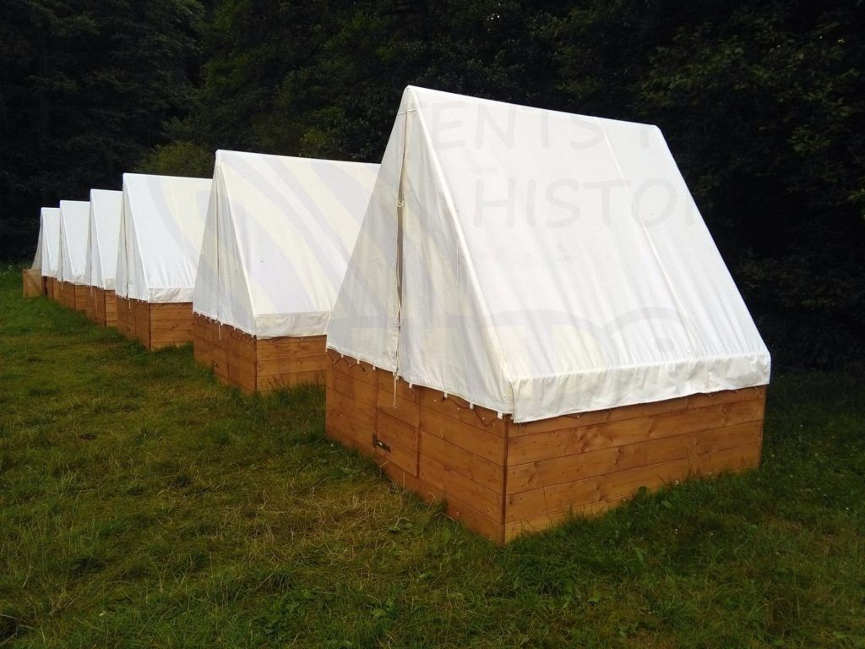
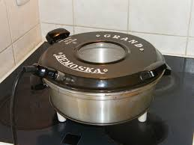
Other czech inventions

Slide 8
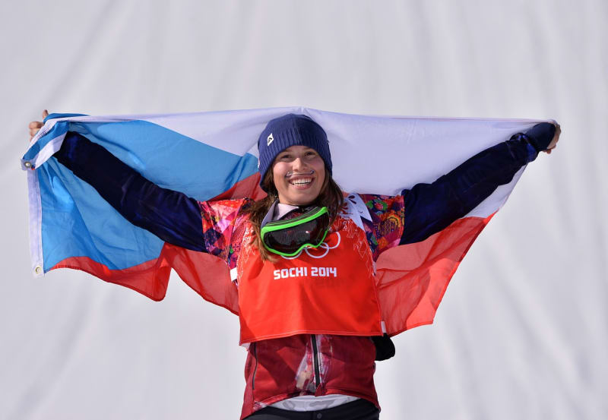
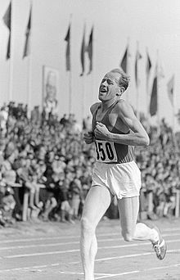
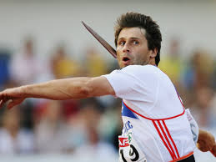
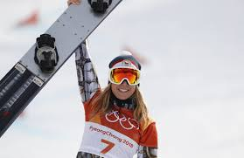
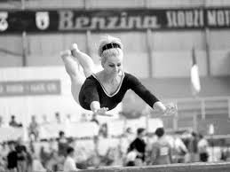
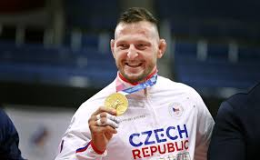
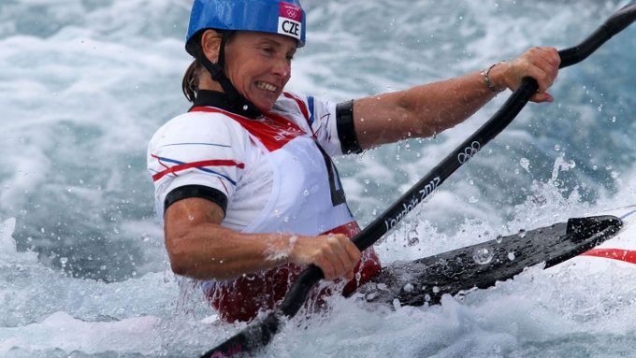
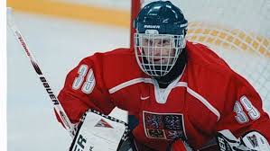
Sport

Slide 9
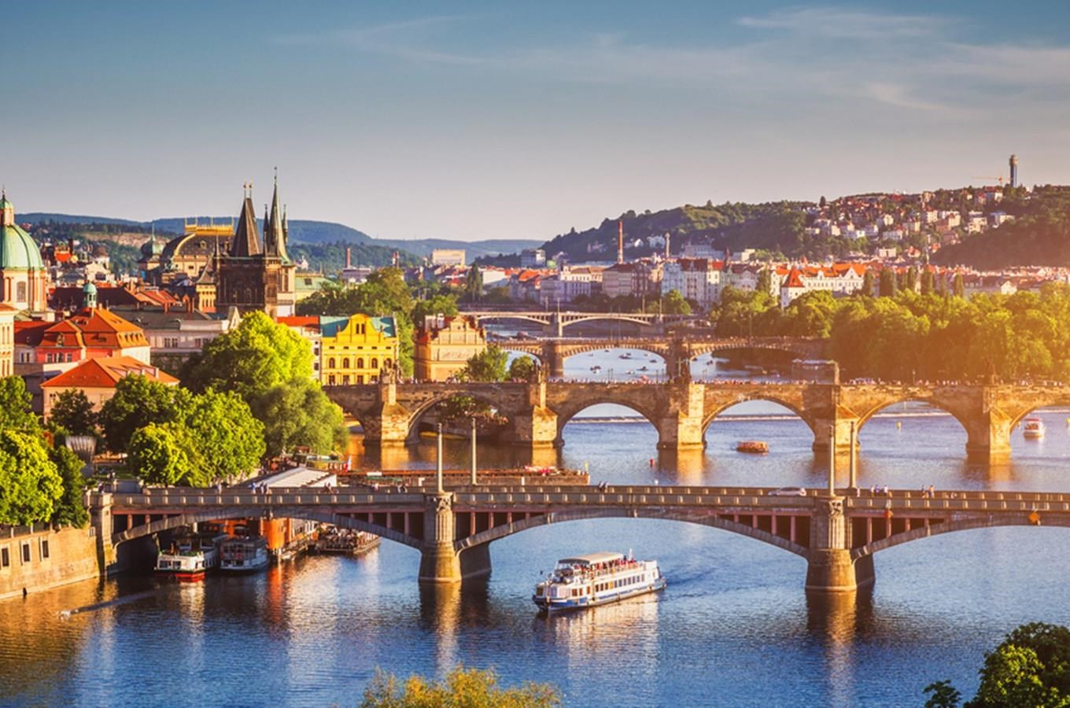
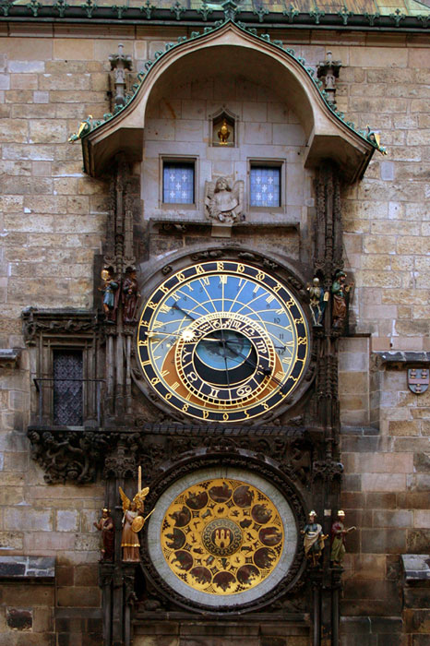
Prague

Slide 10
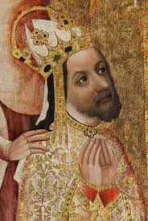
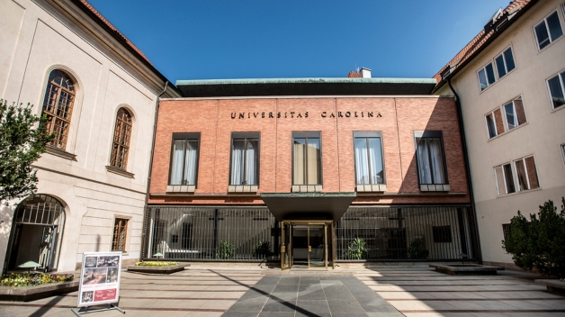
Charles University
The 12. oldest university in Europe
Founded in 1347 by Charles IV.
The largest university in the ČR
Prague, Hradec Králové, Plzeň
17 faculties

Slide 11
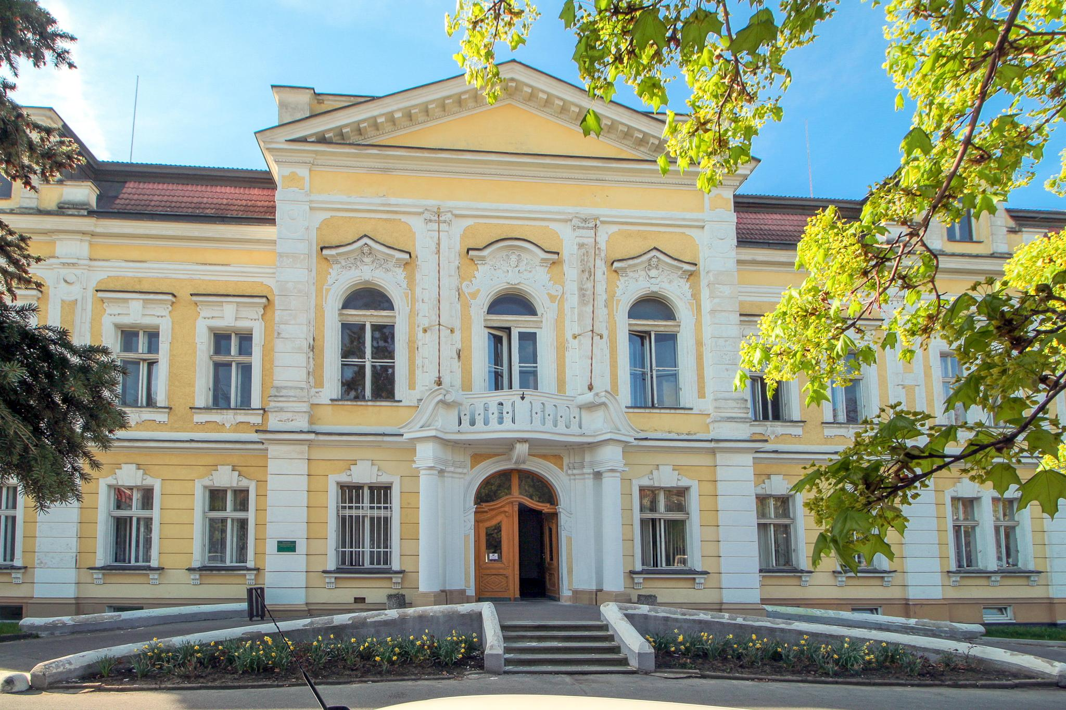
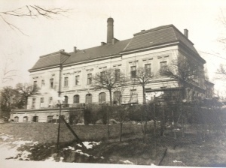
History of third faculty of Medicine
1902 Hospital Královské Vinohrady
1925 the State Health Institute
1953 the division of Faculty of Medicine – The Faculty of General Medicine, the Faculty of Pediatrics, the Faculty of Hygiene
1990 Third Faculty of Medicine

Slide 12
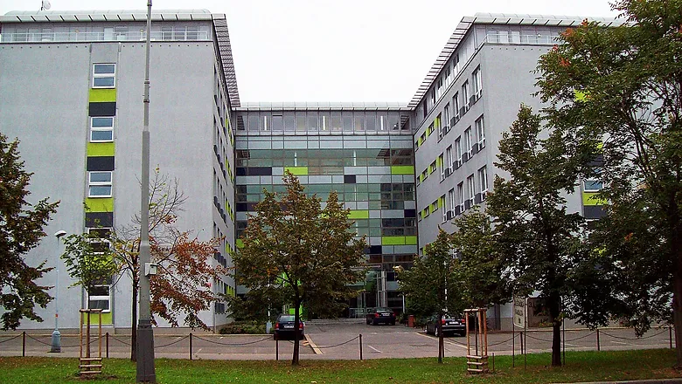
Third faculty of Medicine
General Medicine
Physiotherapy
Public Health
Dental Hygiene
General Nurse
Nutrition Therapy

Slide 13
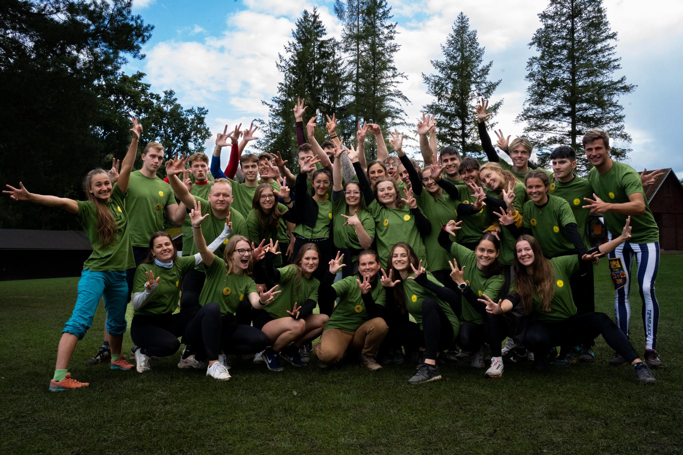
Physio education system

Slide 14
Little Czech vocabulary quiz
Ahoj
Prosím
Jedno
Pivo
Děkuji

Slide 15
Thank you for your attention!

