Slide 1
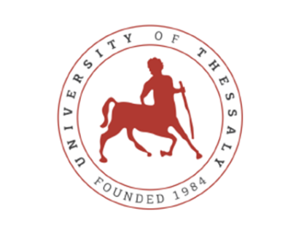
Rehabilitation Techniques to improve the Functional Status of patients with Stroke
Dr. Thomas Besios
Assistant Professor, Department of Physiotherapy, Lamia,
University of Thessaly, Greece

Slide 2
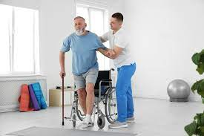
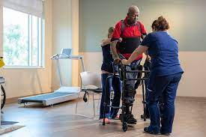
Stroke
Stroke is the term that describes a set of disorders caused by damage to the central nervous system and creates several forms of disability
(Esenwa & Gutierrez, 2015)
Worldwide it is the second most frequent cause of death in people over 60 years of age, the 1st most frequent cause of disability in the population and the 2nd most common cause of dementia
(Jillella & Wisco, 2019)

Slide 3
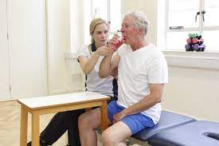
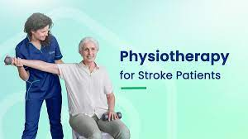
Stroke
It is estimated that soon more than 7 million people every year will be affected by a stroke, most of whom will be permanently disabled, due to the aging of the population on a global scale.
(Feigin et al., 2014; Kavga et al., 2015)

Slide 4
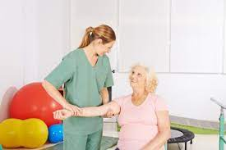
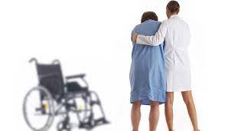
Stroke - Epidemiology
Stroke are the second most common cause of death in people over 60 years of age, the first most common cause of disability in the population and the second most common cause of dementia
(Jillella & Wisco, 2019; Kavga et al. , 2015)
However, differences they also exist in terms of race, as researchers have found that there are many variations. Blacks are twice as likely to have a stroke at a younger age than whites due to high blood pressure
(Feigin & Krishnamurthi, 2011)

Slide 5
Stroke - Epidemiology
In the Asian race and in countries with low individual income there is a high proportion of bleeding events, possibly due to failure to control hypertension (Feigin et al., 2014)
In Greece, since 2000 onwards there is a gradual decline in stroke deaths but the number of people with stroke remains quite high.
Based on the Hellenic Statistical Authority it is estimated that about 310 people per 100,000 residents aged between 45 and 85 years, suffer from a stroke .
In most patients it will leave permanently disabled and 1/3 of them will need medical care at once.
(Kavga et al., 2015)

Slide 6
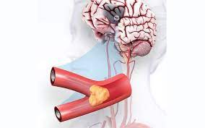
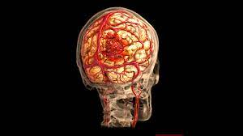
Types of Stroke
Ischemic stroke is either of the thrombotic or embolic type
In a hemorrhagic stroke, there is a rupture of a blood vessel and an outflow of blood into or around the brain
(Carr & Shepherd, 2004; Papageorgiou, 2004)

Slide 7
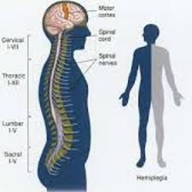
Symptoms
Paralysis on one side of the body,
difficulty forming words,
difficulty swallowing
difficulty walking
problems with balance
difficulty in dressing, eating and
in general trouble self-service
vision problems
(Carr & Shepherd, 2004; Esenwa & Gutierrez, 2015; Kargadou, 2010; Sveinsson et al., 2014)

Slide 8
Causes of Stroke
• Age
• Gender: common in men.
• Previous stroke
• Arterial hypertension.
Alcohol
• Prohibited substances, e.g.
cocaine, amphetamine
• Bleeding from drugs
• Aneurysm and vascular
malformations
• Brain tumors
• Diabetes
• Smoking
(Carr & Shepherd, 2004; Feigin et al., 2014; Jillella & Wisco, 2019; Kargadou, 2010; Kavga et al., 2015; Lee & Lee, 2014; Papageorgiou, 2004)

Slide 9
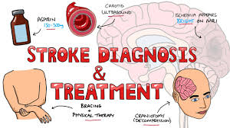
Medical Treatment
If it is an ischemic episode, within the first 3-4 hours intravenous thrombolysis can be done. Alternatively, mechanical thrombectomy, i.e. removal of the clot through an intravascular catheter, can be performed
(Campbell, 2017; Kargadou, 2010)
Furthermore, if the episode is hemorrhagic, neurosurgery to remove the hematoma is usually performed
(Campbell, 2017; Carr & Shepherd, 2004)

Slide 10
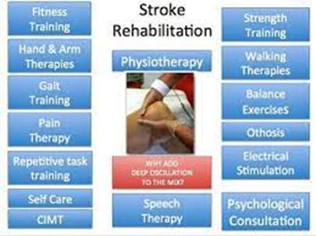
Multidisciplinary approach
Doctors
Nurses
Physiotherapists
Occupational therapists
Speech therapists
Psychologists
Dieticians
Social worker
Family

Slide 11
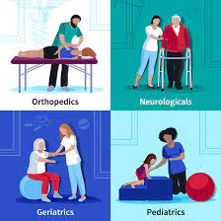
Physical therapy
Physical therapy plays a key role in the management of disorders in stroke patients. It focuses on achieving functional movements, developing the patient's maximum potential.
At the same time, therapists offer support and training to patients' relatives to manage each sufferer in their daily life activities
(Lee et al., 2018; Rocha et al., 2021)
All known interventions have as their aim the restoration in the first degree or even the preservation of the physical, motor, psychological and social characteristics.

Slide 12
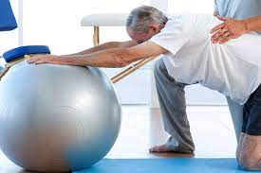
Physical therapy
The different approaches aim to improve the function ability of the patients. The goal of rehabilitation is also to reduce secondary complications such as musculoskeletal disorders.
Most approaches are based on the principles of neuroplasticity, with the long-term goal of improving motor patterns. Despite the abundance of techniques, there is no strong research evidence that one intervention is more effective than another.
Typically, therapists use combination interventions that rely primarily on function
(An & Shaughnessy, 2011; Dimyan & Cohen, 2011; Winstein et al., 2016)

Slide 13
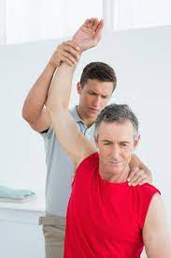
Starting physical therapy
Period of 2 weeks should have passed from the stroke, as well as the intensive active movements of the limbs from the first day of the stroke episode is not indicated.
The researches show that the active mobilization of the patient when starts after 2 weeks has the same and better results than started the day after the stroke.
(Belagaje, 2017; Coleman et al., 2017)

Slide 14
Physiotherapy Treatment – ​​A Review of Different Methods of Intervention
The physical therapy approach to the patient includes many types of treatments depending on the symptoms of each patient.
Research has shown that the most important thing in stroke recovery is movement and therapeutic exercise.
Therapeutic Programs should include exercises of the whole body, upper and lower limbs, as well as balance exercises both on stable ground and on sloping or uneven ground (taking advantage role of the environment)
(Han et al., 2017; Smedes & Giacometti da Silva, 2019; Vahlberg et al., 2017; Vér et al., 2016)

Slide 15
Methods of Intervention
Furthermore, research has shown that depending on the symptoms, Botox injection and Tens currents are used
(Dong et al., 2017; Sun et al., 2019)
Therapists also use several types of splints to improve the functionality of patients. Research has shown moderate to good results in the placement of splints during physical therapy treatment
(Amini et al., 2016; Khallaf et al., 2017)
In addition, patients need mental and psychological support, in order to reduce the chances of high levels of stress
(Guggisberg et al., 2019, Harrison et al., 2017; Schöttke & Giabbiconi, 2015)

Slide 16
Bobath – PNF method
In 2016, Krukowska et al., conducted a study on ischemic stroke patients to see the effect of the Bobath and PNF.
Both groups had an improvement in their balance, but the group that had received the Bobath method presented better results and a greater statistically significant difference p<0.05, compared to the group that had received the PNF intervention
(Krukowska et al. , 2016)

Slide 17
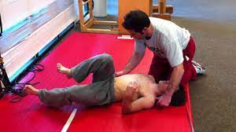
Vojta therapy improves postural control
Aim of the trial was to test the hypothesis that Vojta therapy - approach improves postural control and motor function in patients with acute ischemic stroke (AIS).
Methods: RCT, included patients with severe hemiparesis and randomly assigned them to Vojta therapy or standard physiotherapy within 72 h after stroke onset.
Results: Forty patients (20 per group), Median age was 75 (66–80) years, 50% were women.
This first randomised controlled trial of Vojta therapy in acute stroke patients demonstrated better improvement of postural control through Vojta therapy compared to standard physiotherapy.
(Corina Epple et al., 2020)

Slide 18
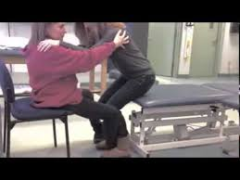
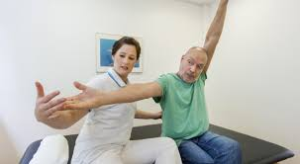
Methods of Intervention
Kılınç, et al., (2016), studied the effects of Bobath on trunk control, upper and lower limb function, gait, and balance in stroke patients
A total of 22 patients voluntarily participated in the study.
Evaluation: Trunk Impairment Scale (TIS), (STREAM), 10-m Walking Test, BBS, Functional Reach (FRT) and Timed Up-and-Go (TUG).
Program for 12 weeks (3 days per week for 1 hour).
In conclusion Bobath rehabilitation programs improved trunk performance, balance and walking ability in hemiplegia patients after stroke more than conventional physiotherapy programs.

Slide 19
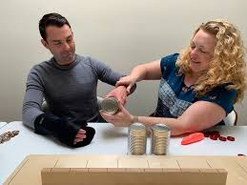
Methods of Intervention
Rocha et al (2021), in a blind RCT evaluated the effect of CIMT on the functionality and quality of life (Quality of life - QOL) of chronic hemiparetic patients.
30 people were divided into two groups: Control (CG) and CIMT (CIMTG).
Both protocols used in the study were effective, but the CIMT protocol showed benefits in the recovery of functionality of the hemiparetic upper limb, in the functional range and in the reduction of muscle tone.
(Rocha et al., 2021)

Slide 20
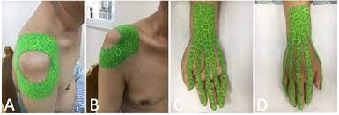
Methods of Intervention
Huang et. al (2016) measured the effectiveness of shoulder taping in a RCT
44 patients with subacute stroke and hemiplegia participated in the study
For hypo acute stroke patients, tape therapy does not provide improvements in upper extremity function, daily activity, and quality of life
(Huang et al., 2016 )

Slide 21
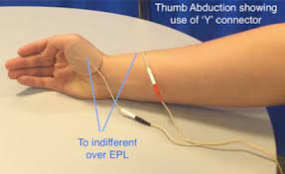
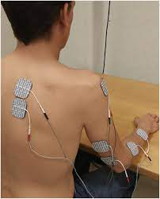
Methods of Intervention
Almytairi et al., 2021, studied the effects of Neuromuscular Electrical Stimulation on plantar flexor spasticity, walking performance and self-reported health outcomes in people with chronic stroke.
44 participants were recruited
The result of the research showed that the use of 4 weeks of NMES has a significant effect on the improvement of plantar flexor spasticity, dorsiflexor muscle strength, walking speed.
( Almutairi et al., 2021)

Slide 22
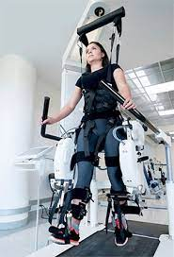
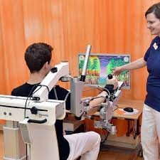
Robotic therapy
Neha Singh et al., 2021, compared the rehabilitation effectiveness of robotic-therapy training sessions with conventional therapy in patients with stroke.
Patients were randomly assigned to receive an intervention of 20 sessions of 45 min each, five days a week for four weeks, in Robotic-therapy Group (RG) (n = 12) and conventional upper-limb rehabilitation in Control-Group (CG) (n = 11).
Robotic-exoskeleton training showed improvement in motor outcomes and cortical-excitability in patients with stroke.

Slide 23
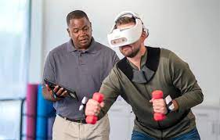
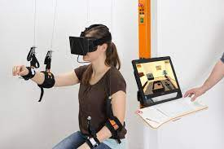
Virtual Reality
Jie Hao et al., Effects of Virtual Reality Intervention on Neural Plasticity in Stroke Rehabilitation: A Systematic Review,2022.
Medline via EBSCO, Embase, PsycINFO, IEEE Explore, Cumulative Index of Nursing and Allied Health and Scopus.
VR-induced changes in neural plasticity for survivors of stroke. The results found Positive correlations between the neural plasticity changes and functional recovery of VR-based therapeutic rehabilitation in stroke.

Slide 24
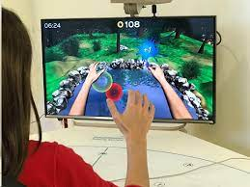
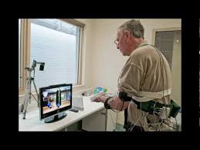
Video games Rehabilitation
Isabelle Laffont et al.,2019, Rehabilitation of the upper arm early after stroke: Video games versus conventional rehabilitation. RCT
Intervention: A 45-min additional session of conventional (OT) or a VG-based OT session as add-on therapy to usual rehabilitation programs, 5 days/week for 6 weeks.
In general, we cannot conclude that video gaming and conventional OT led to different long-term sensorimotor recovery of the UL after sub-acute stroke.

Slide 25
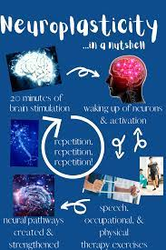
PRINCIPLES OF NEURAL PLASTICITY IN REHABILITATION
Neuroplasticity can be considered the neural mechanism of motor function recovery due to physical therapy intervention.
Physiotherapists need to determine which interventions are most effective in restoring movement and inducing plasticity after brain injury.
Movement recovery after brain damage is a learning process supported by the same or similar neural mechanisms that promoted motor learning when the brain was healthy.

Slide 26
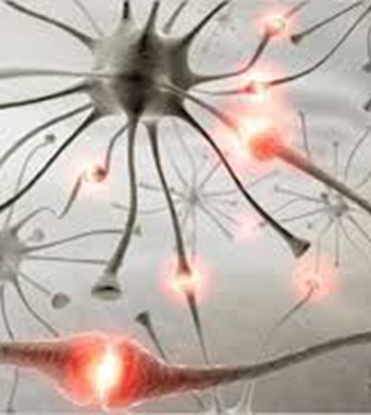
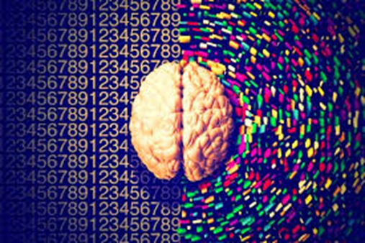
PRINCIPLES OF NEURAL PLASTICITY IN REHABILITATION
Changes in plasticity in the motor cortex result in motor learning in the intact brain but also motor restart in the damaged brain.
Physiotherapy interventions that lead to pathological motor patterns are established in the brain and are difficult to be changed.
Rehabilitation parameters that lead to rapid recovery are related to the intensity of physiotherapy, recovery time and the age of the patient

Slide 27
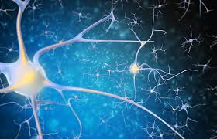
Use it or lose it
Synapses that are not actively involved in the performance of motor functions for a long period eventually disappear.
Functional rehabilitation programs leads to rapid and great plasticity of the brain.
Use it and Improve it

Slide 28
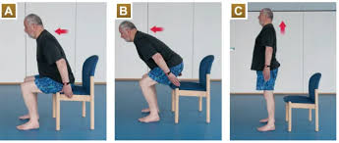
Specificity matters
Rehabilitation associated with functional movements produces greater functional benefits.
Repetition of a newly acquired movement is required to produce lasting neural change in the brain.
Repetition of movements is required outside of Physical therapy session.
The number of sessions plays a decisive role in acquiring new movement patterns
(Kleim et al 2004, Lang et al 2007)

Slide 29
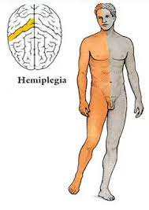
Time matters
Rehabilitation should be done as early as possible and not late (early intervention).
Training in patient-related functional movements will improve the patient more quickly.
(Adkins et al 2006, Biernaskie et al 2004, Barbay et al 2006)

Slide 30
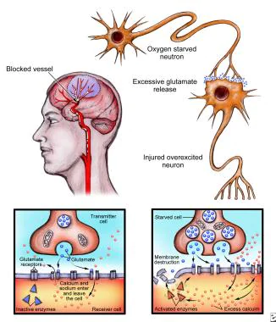
Age matters
Plasticity induced by motor retraining occurs more readily in younger brains.
Neuroplastic responses are reduced in the aged brain.
(Nieto-Sampedro & Niet-Diaz 2005, Markus et al 2005,
Zhao et al 2005)

Slide 31
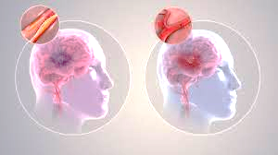
What can be done to enhance neuroplasticity and functional recovery potential?

Slide 32
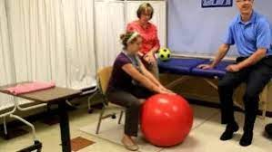
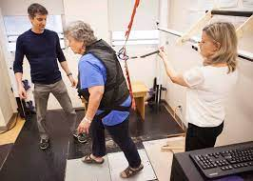
Today rehabilitation protocols rely on motor learning to induce neural plasticity
Motor retraining should be:
Function oriented
Substantive and challenging
Repetitive and intensive
Provided in an enriched environment
The movements should be carried out with as much as possible normal mechanical position and normal alignment of the joints

Slide 33
Financial Approach
In the European Union, the total annual cost has been estimated at 27 billion euros
In the UK, including treatment and total lost productivity, the cost is £8.9 billion per year (Kavga et al., 2015)
The cost of stroke in developed countries is estimated to be between 1.6% and 6.9% of total health expenditure
(Evers et al., 2004)
In the United States of America, in 2010, the cost was estimated at $28.3 billion and is projected to triple to $95.6 billion by 2030 (Heidenreich et al.,2011)

Slide 34
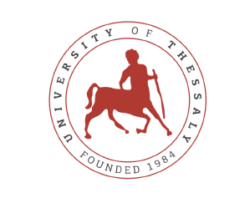
Thank you ……………….

