Slide 1


Neurorehabilitation in multiple sclerosis
prof. PhDr. Kamila Řasová, Ph.D.
Department of rehabilitation, 3. LF UK a FNKV
Department of revmatology and rehabilitation, 3. LF UK a FTN
Notes:
Dear audience,
It is my pleasure to briefly present current trends in neurorehabilitation of people with MS.

Slide 2
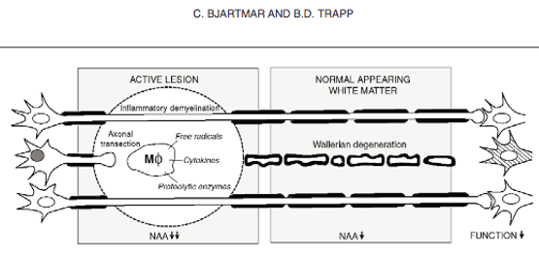

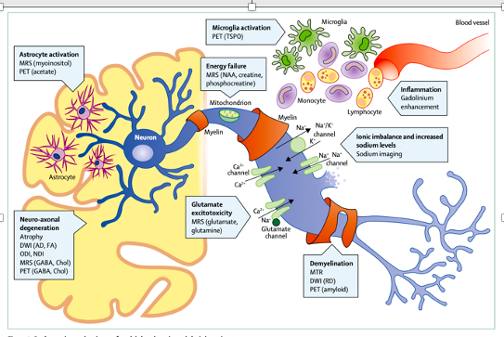
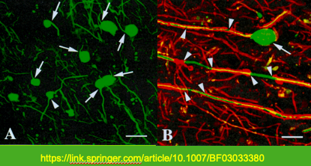
Notes:
MS is a chronic autoimmune disease, pathologically characterized by demyelination, perivascular inflammation and axonal degeneration in the central nervous system.

Slide 3


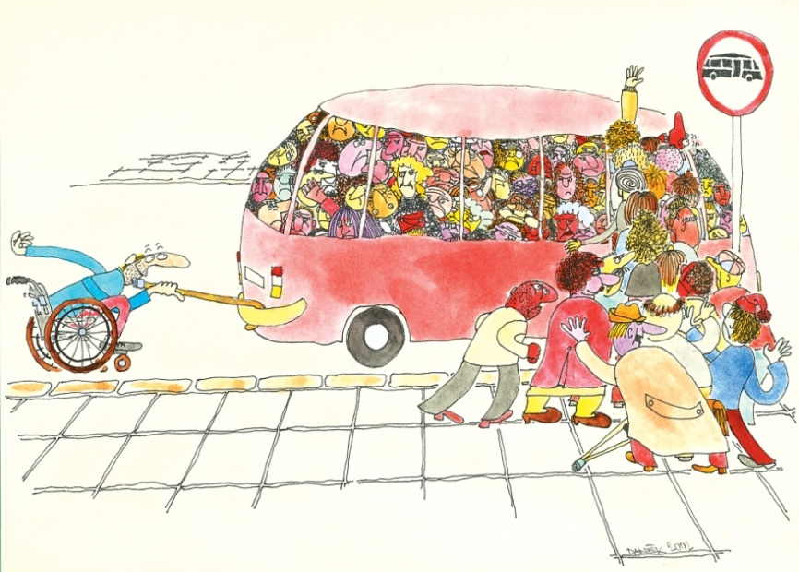
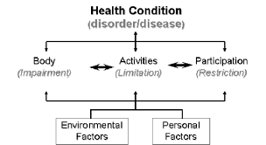
weakness, spasticity,
ataxia,
tremor,
balance disorders,
fatigue,
depression
Neurological Rehabilitaton, 2001
Notes:
It causes acute or subacute neurological abnormalities, which are manifested by a wide range of clinical symptoms such as muscle weakness, spasticity, ataxia, tremors, balance disorders, fatigue and others. These lead to a whole range of complications and problems that negatively affect the quality of life.

Slide 4
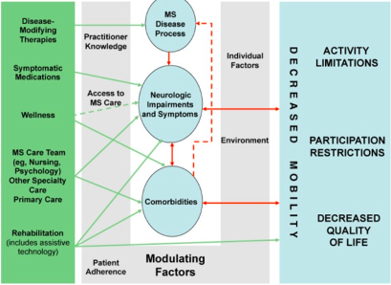

Notes:
Due to disease modifying drugs, progression of MS slows down, which allows effective rehabilitation.

Slide 5
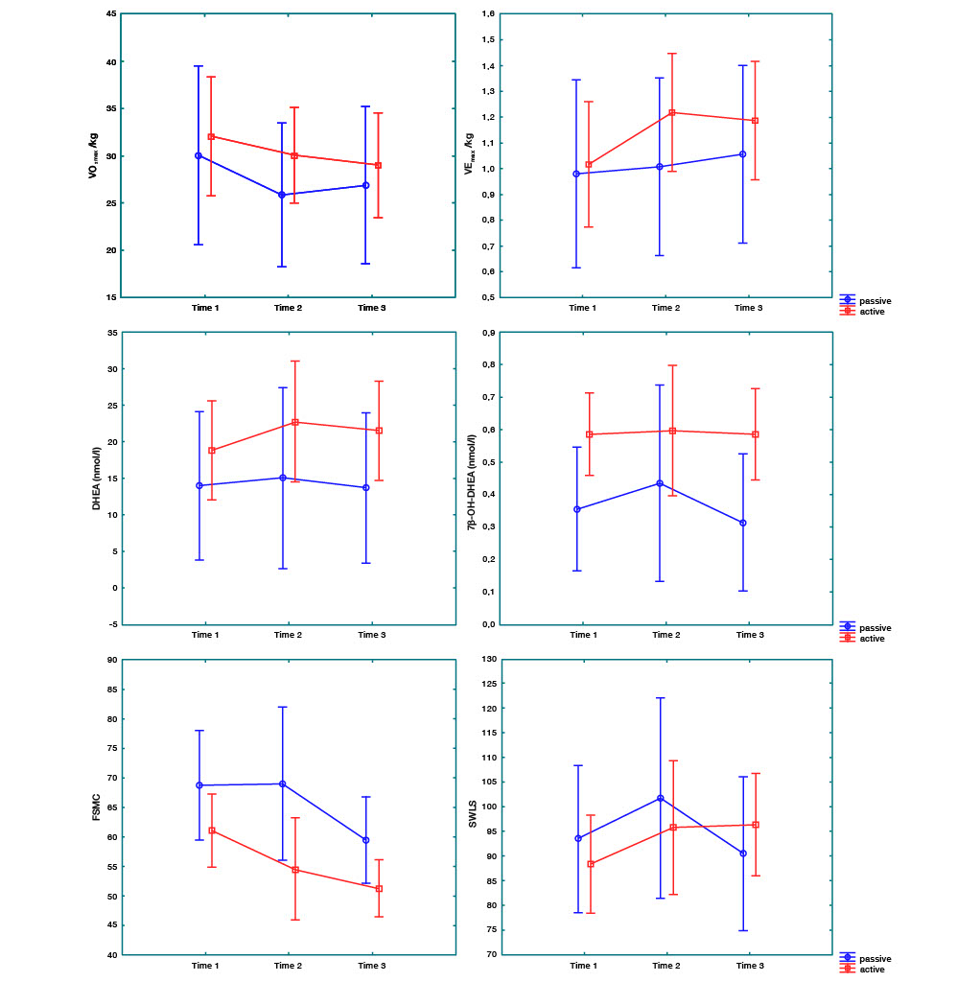
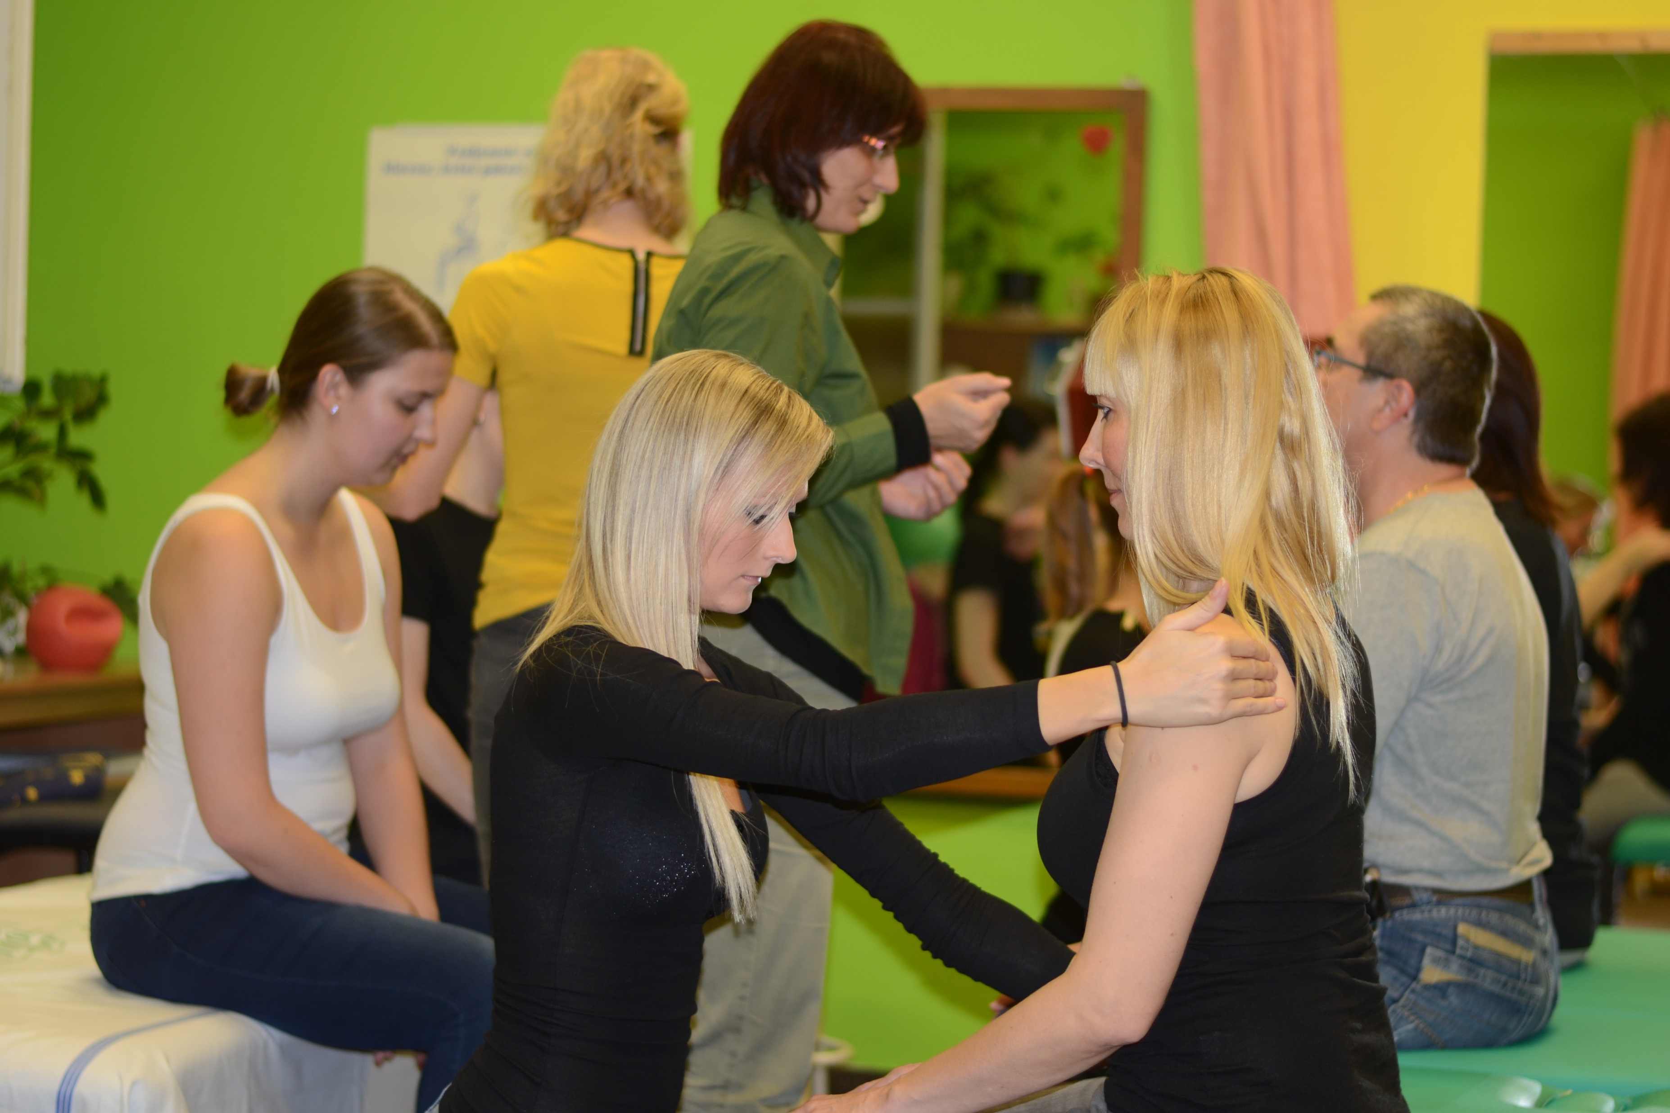
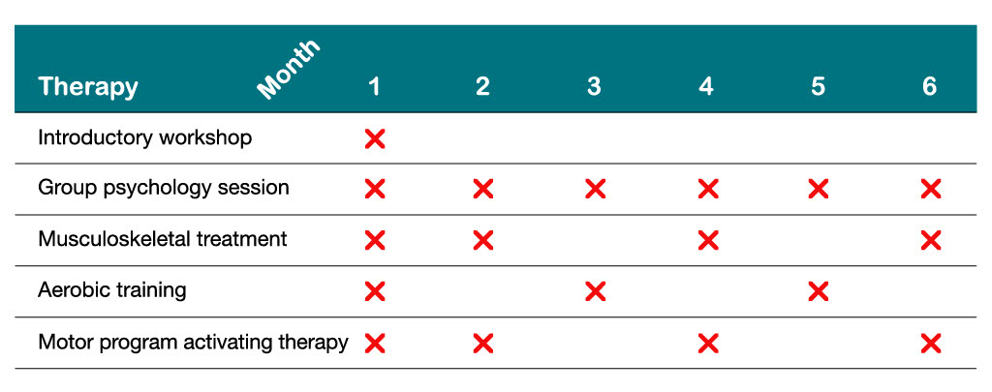
Early rehabilitation
Hrušková et al., 2024
Notes:
In the initial stage of the disease, impaired functions can be restored thanks to plastic and adaptive processes of the CNS. These can be supported by appropriate early rehabilitation.
Our experience shows that people with an active approach benefit more from the comprehensive program (including group psychotherapy and individual physiotherapy - aerobic training, musculoskeletal treatment, and neuroporpioceptive “facilitation inhibition”) that improves physical fitness, reduces fatigue and improves life satisfaction with long-term benefit (at 12-month follow-up). Moreover, level of DHEA is released.

Slide 6
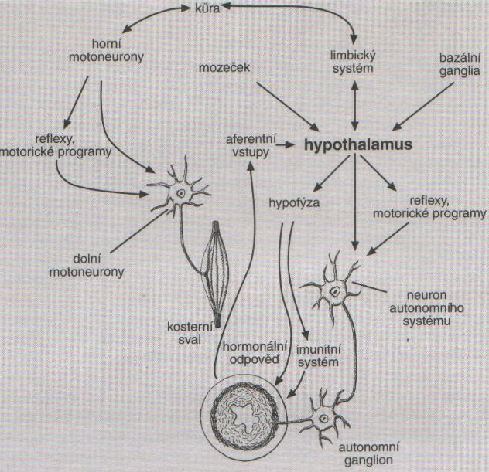
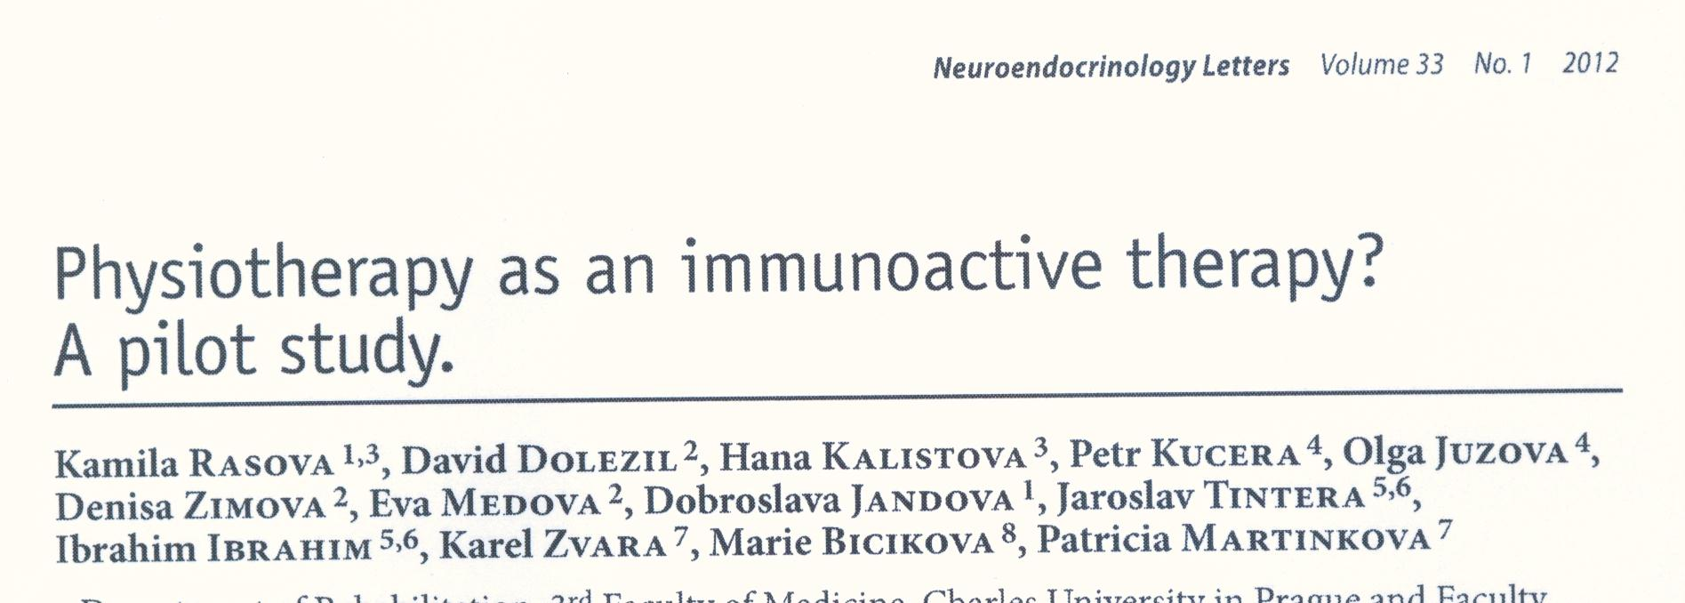
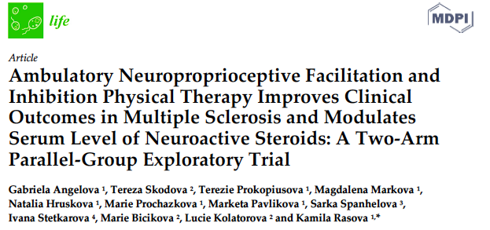
Psycho-neuro-endocrine-immune regulation
Dehydroepiandrosterone is a steroid neurohormone that reduces inflammatory processes, modulates cellular immunity, has neuroprotective effects, improves cognitive functions, strengthens memory, and plays a role in myelination.
Physiotherapy influences not only the nervous, but also the immune and endocrine systems, which slows down the progression of the disease.
Prof. Helena Tlaskalová-Hogenová, 2001
Notes:
Dehydroepiandrosterone is a steroid neurohormone that reduces inflammatory processes, modulates cellular immunity, has neuroprotective effects, improves cognitive functions, strengthens memory, and plays a role in myelination.
It follows, that physiotherapy influences not only the nervous, but also the immune and endocrine systems, which slows down the progression of the disease.

Slide 7
Notes:
However, permanent neurological impairment often develops, which requires comprehensive, regular and long-term rehabilitation.

Slide 8
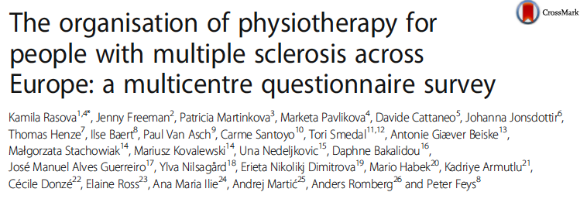
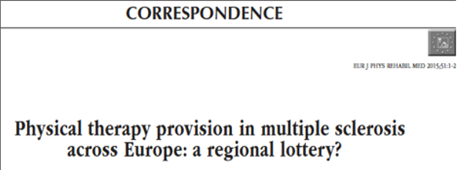
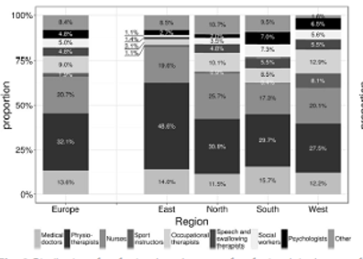
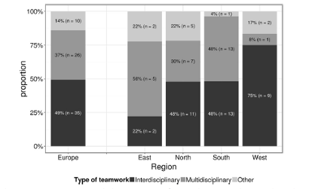
Notes:
Successful treatment depends on good organization. Although an interdisciplinary approach (where all team members work together) is recommended, from our survey follows that it is unfortunately not yet offered to everyone.

Slide 9
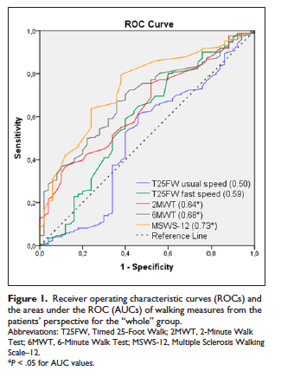
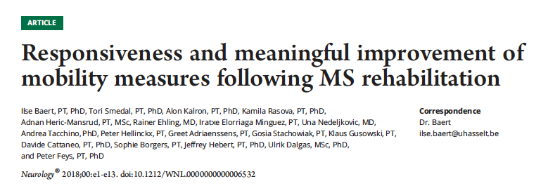
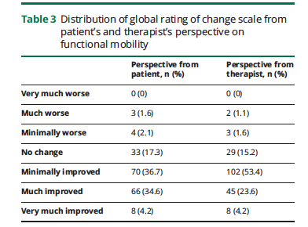
Psychometric properties of clinical tests in physiotherapy of MS
Notes:
Each member of the team should consider the problem from their own perspective in the context of comprehensive treatment. It is necessary to use appropriate instruments that have good psychometric properties. In physiotherapy, a lot of tests are used to assess mobility. In our research, it has been shown to be clinically more informative to examine long-distance walking tests rather than short-distance tests. It turns out to be more suitable, especially in people with moderate to severe motor deficits, to use self-rating scales (the MSWS - 12 questionnaire).

Slide 10
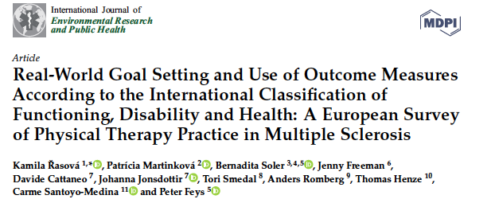
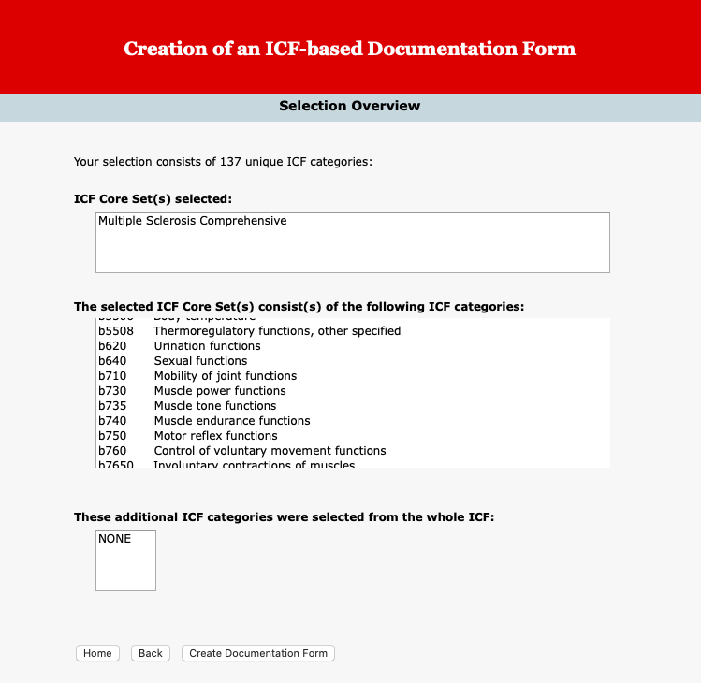
The recommendations of the World Health Organization
Identification of all aspects of the activity that the treated person wishes to achieve again
Return to original level of functional ability and normal daily activities
  The ICF categorical profile
Notes:
Based on the recommendations of the World Health Organization, it is necessary to focus on 1) identifying all aspects of the activity that the treated person wants to achieve again, and 2) returning to the original level of functional abilities and normal daily activities, if possible. . It turns out that the ICF categorical profile is suitable for this.

Slide 11
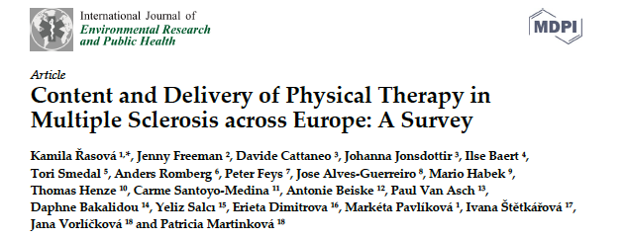
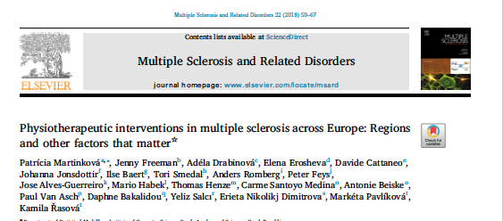
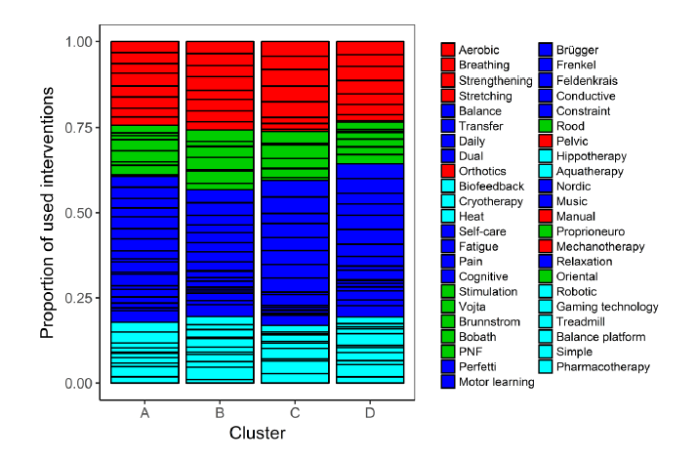
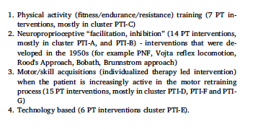
Notes:
In the physiotherapy of people with MS, a number of methods are used, which we categorized in our work as physical activity, Neuroporpriocpetive "facilitation, inhibition", motor/skill acquisition, and technologies based.

Slide 12
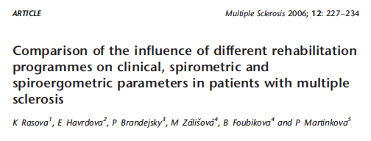
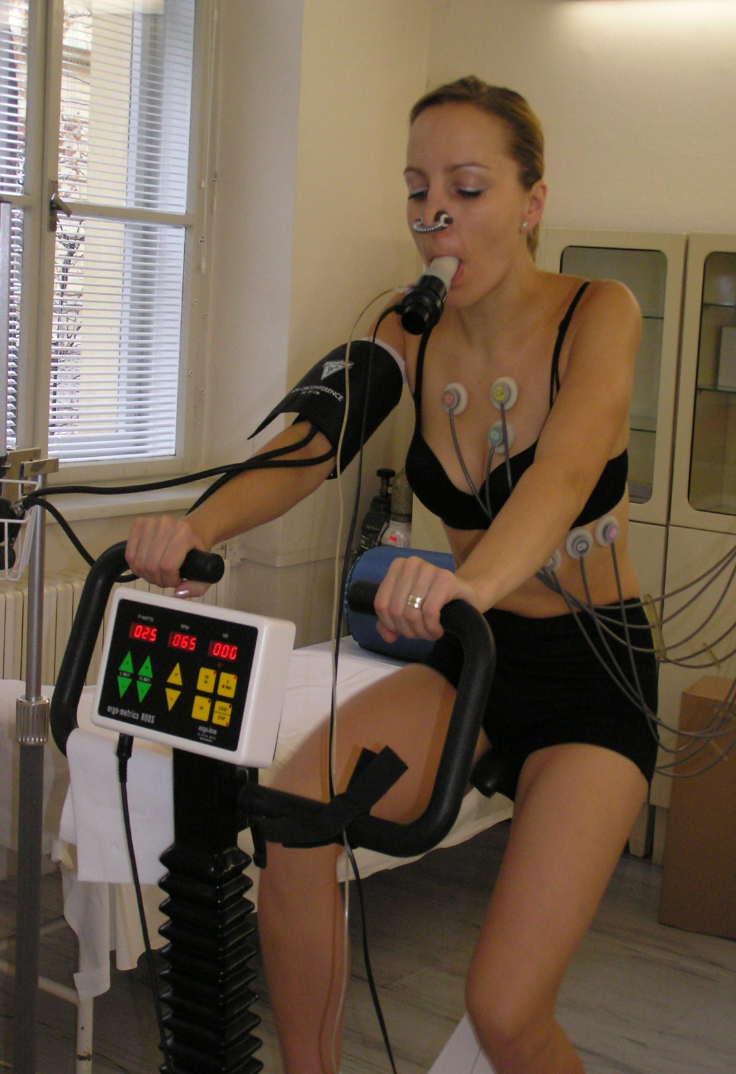
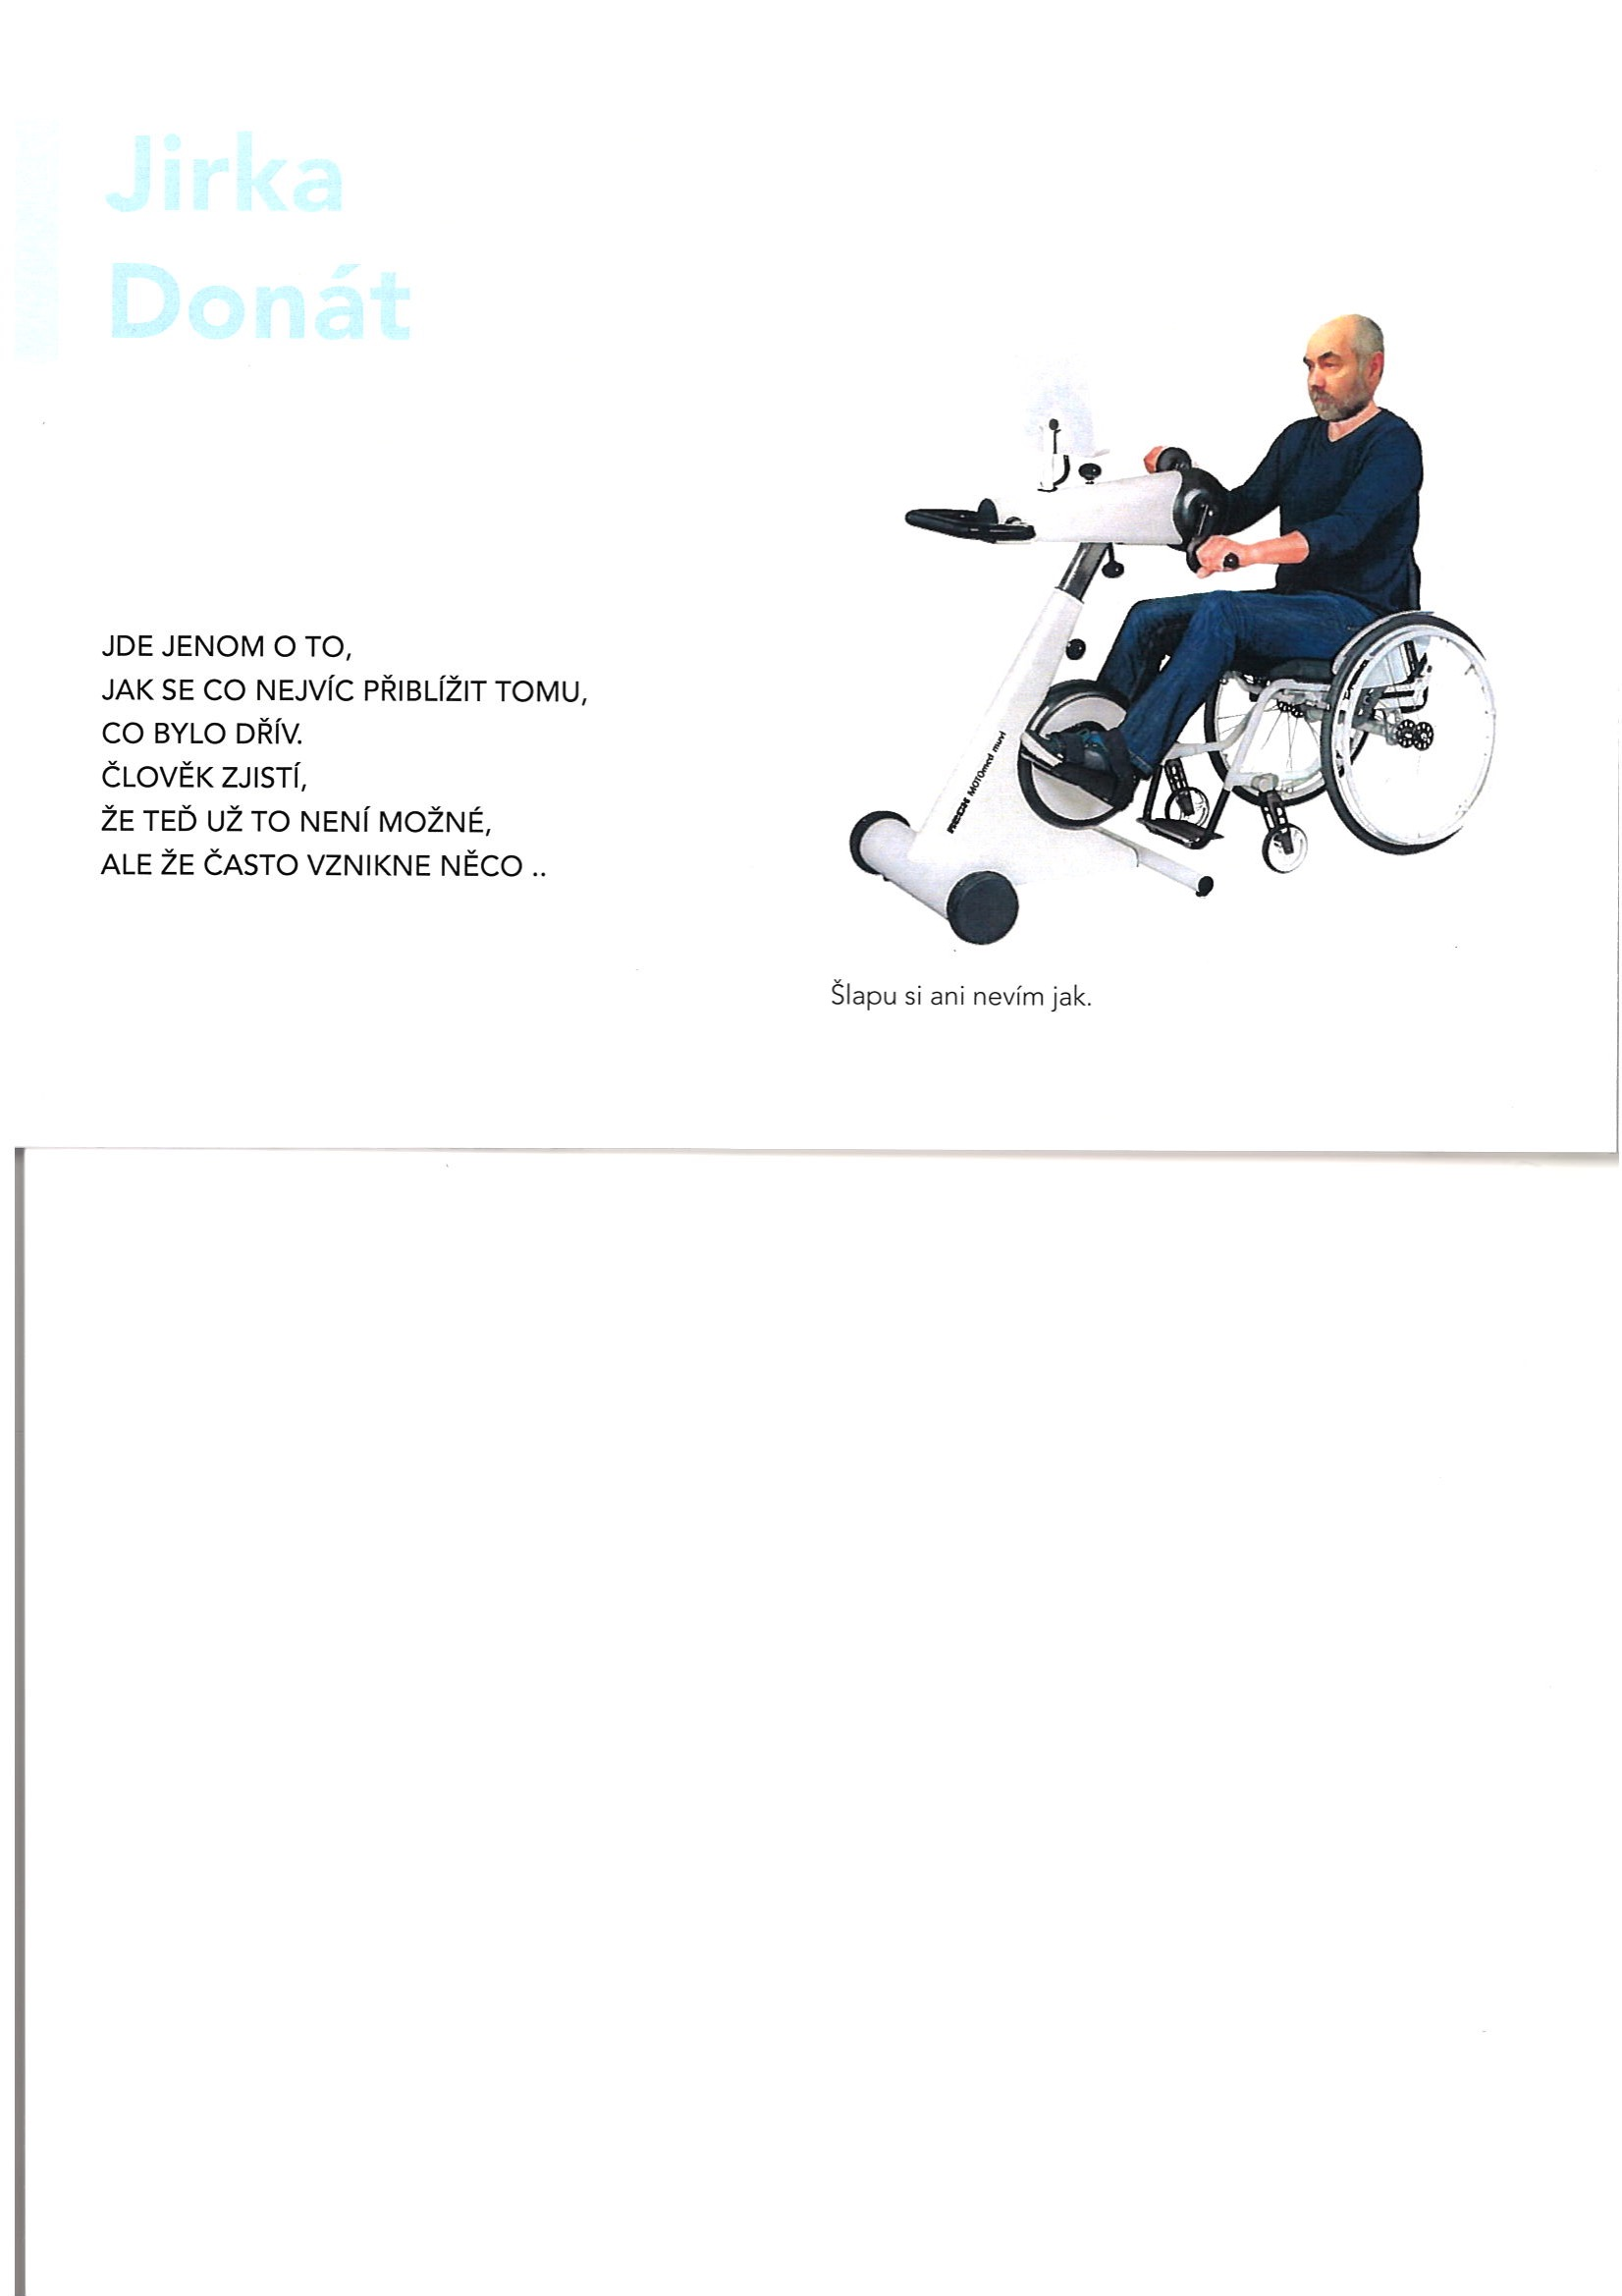
Physical activity (fitness, endurance, resistance)
to do all activities until the first signs of fatigue
Subjective symptom – it is not possible to quantify
Chronic - can bring some relevant information?
Inactivity has negative impact
Physiological fatigue
Neuromuscular fatigue
x
Fatigue accompany depression
Tiredness
regular, correctly indicated and controlled aerobic training
Notes:
From the point of view of access to physical activity, it is important to advise people with MS how they can be loaded. Even twenty years ago, people with MS were advised to do all activities until the first signs of fatigue. However, fatigue is not a suitable threshold for workload, as it is a subjective symptom that cannot be quantified and which, due to its high frequency and chronic nature, loses its significance as a warning signal against overload. On the contrary, it is a symptom that can be positively influenced with the help of physiotherapy. However, it is necessary to respect the neuromuscular type of fatigue and fatigue as a physiological response to physical or mental stress.

Slide 13
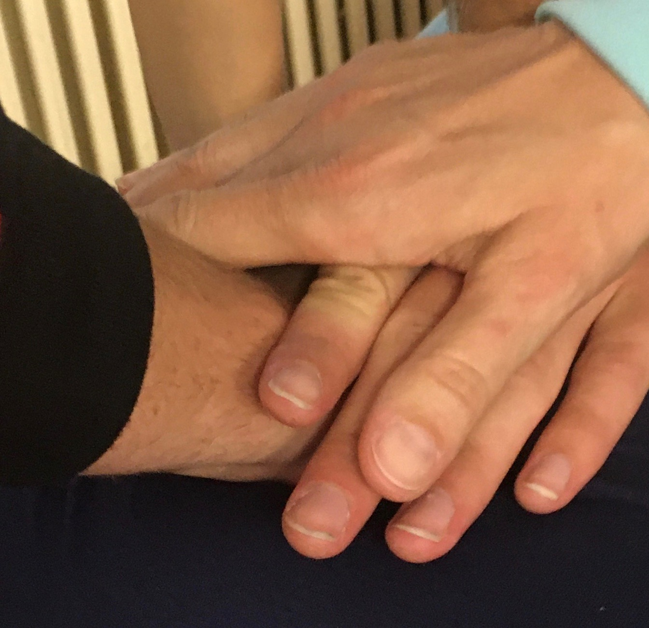
Physical activity (fitness, endurance, resistance)
Musculoskeletal system:
  symptoms resulting from neurological impairments (e.g. spasticity)
  comorbidities of musculoskeletal system (e.g. osteoporosis)
  functional problems (low back pain)
the most relevant link in the pathogenic chain based on the differential diagnosis of the motor system
to normalize the flow of afferent information into of the sensorimotor system and correct muscle imbalance
Notes:
In addition to gaining fitness, endurance, and resistance, it is very important to ensure the quality function of the musculoskeletal system. It can be affected by symptoms resulting from neurological impairments (e.g. spasticity), comorbidities of musculoskeletal system (e.g. osteoporosis) or functional problems (low back pain).
It is necessary to find the most relevant link in the pathogenic chain based on the differential diagnosis of the motor system, to focus on the cause of the difficulties (not on their clinical manifestation). The principle of treatment is to normalize the flow of afferent information into of the sensorimotor system (for example by soft techniques) and correct muscle imbalance (by methods chosen based on the differential diagnosis of hypertonus and hypotonus).

Slide 14
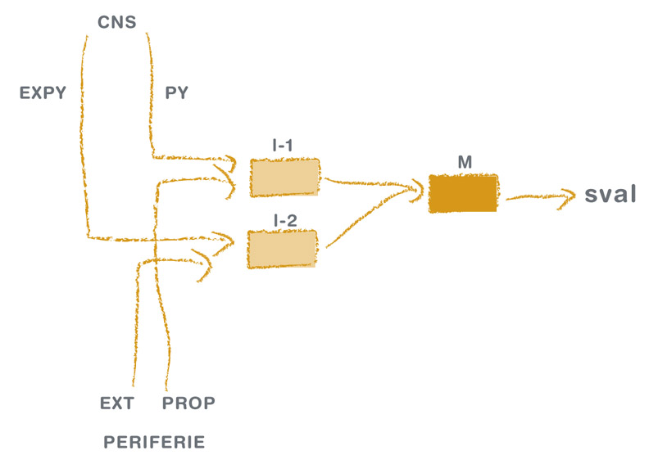
Neuroproprioceptive „facilitation, inhibition“
PT enhances the
effectiveness of the synaptic connections among neurons forming functional networks, which
leads to the evocation of movement by some otherwise weak and insufficient stimuli.
Véle F. Kineziologie pro klinickou praxi, 1997
Notes:
To deal with neurological problems, neuroproprioceptive "facilitation, initiation" is the most frequently used physical therapy category in the Czech Republic. Its principle is described in the graph: All CNS pathways end on the motor cells of the anterior horns of the spinal cord. When they are sufficiently irritated, the muscle is activated, and the movement is carried out. If the CNS is damaged, it is possible to replace the stimuli necessary for irritation from the periphery.
PT enhances the
effectiveness of the synaptic connections among neurons forming functional networks, which
leads to the evocation of movement by some otherwise weak and insufficient stimuli.
Goals of therapy:
To increase the level of irritation (reduce the excitability threshold) of the motoneurons so that the impulses coming from the center can be applied, i.e. cause the cell to discharge and the muscle to contract.
Maintain optimal conduction/function of motor pathways and optimal excitability of control or regulatory structures.
Change (increase, possibly decrease) the activation level at the synapses (motor cells in the anterior corners of the spinal cord).

Slide 15
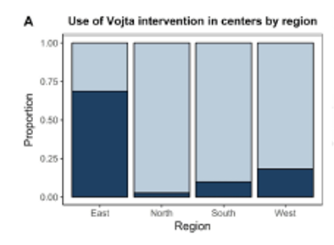
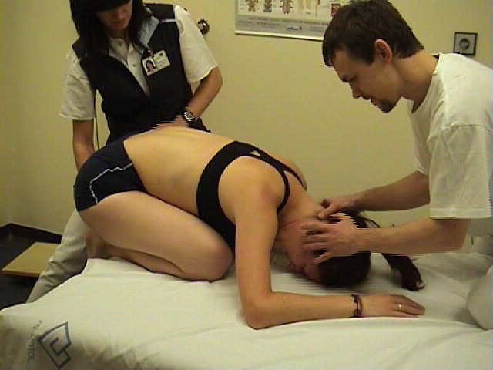
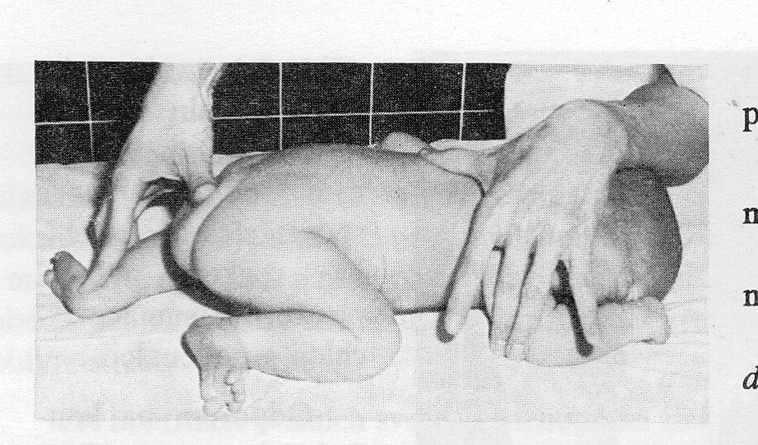
Schroier B. Valouchova P., vlastní archiv
Vojta V., 1995
Notes:
One of the most used methods that represents this category is VRL.

Slide 16
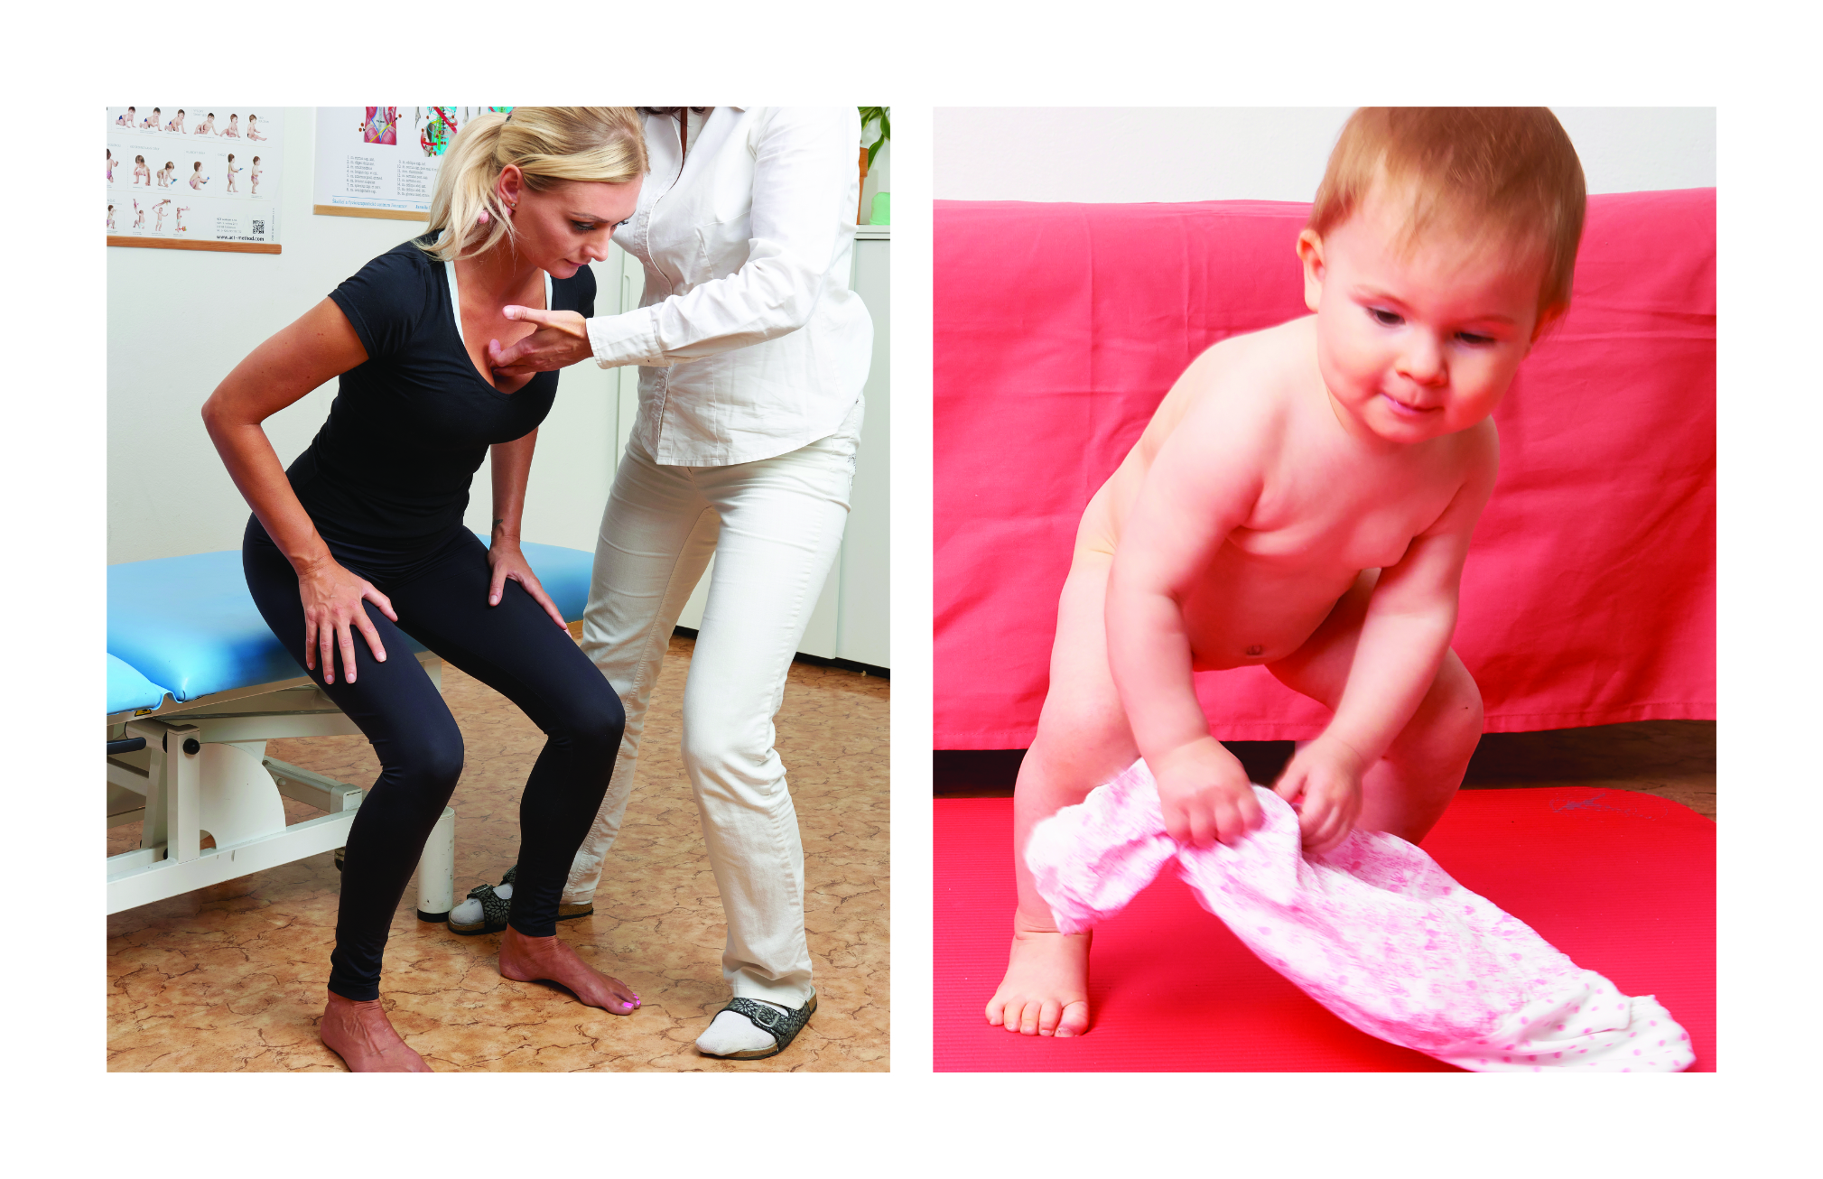
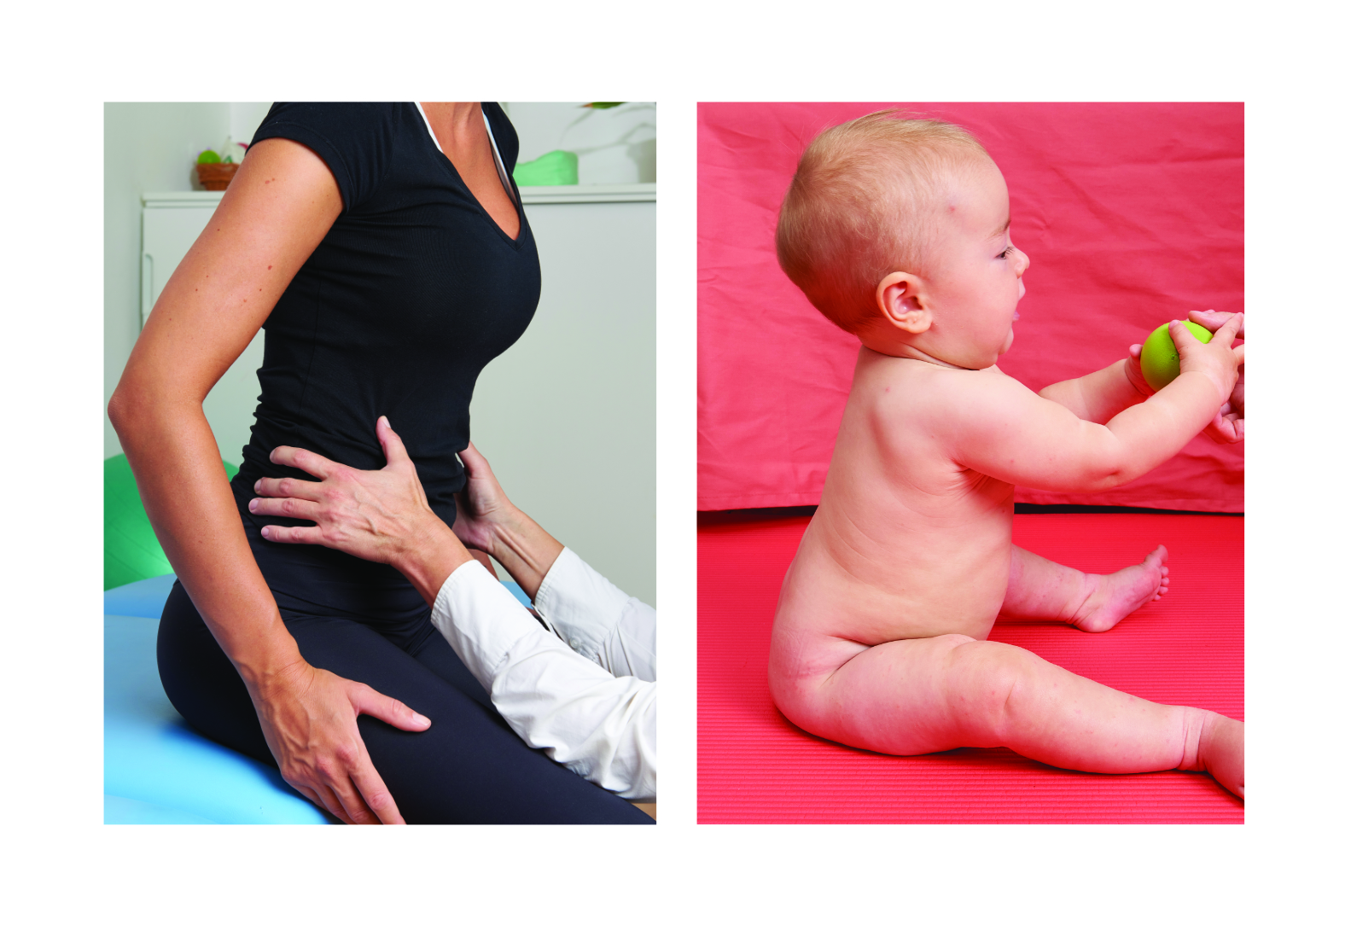
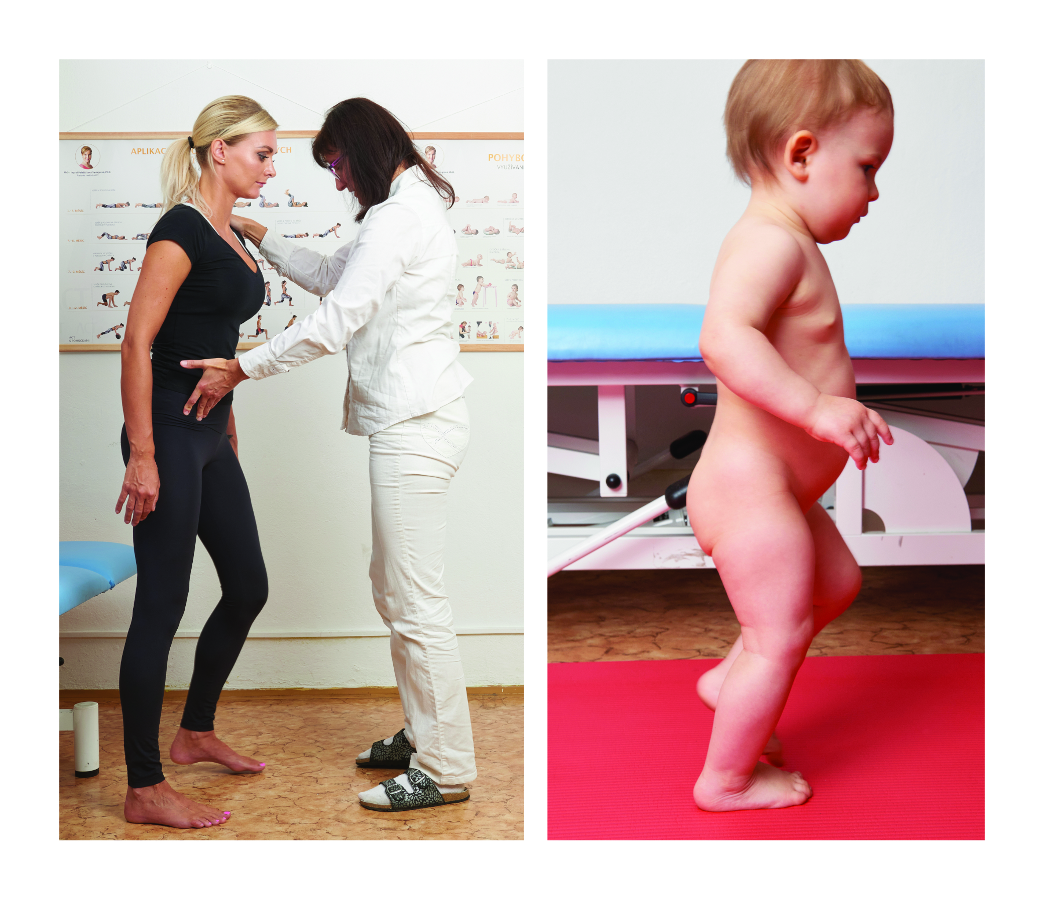
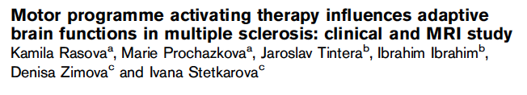
Motor program activating therapy
Principls of neuroproprioceptive “facilitation, inhibition”
Combination of afferent stimuli
Principles of sensomotor learning
Repetition
Different conditions and environment
Postural positions based on ontogenesis
Activation of motor programs at subcortical level
Activation of motor patterns
Notes:
For my clinical work, I developed own method MPAT, in which motor programs (genetically programmed motor patterns) are activated by a combination of appropriate afferent stimuli in positions corresponding to the child's motor development. This activates interplay between the postural and erecting system and the system of phasic movements. At the same time, the principles of sensorimotor learning are applied - motor programs are activated repeatedly in different conditions and environments.

Slide 17
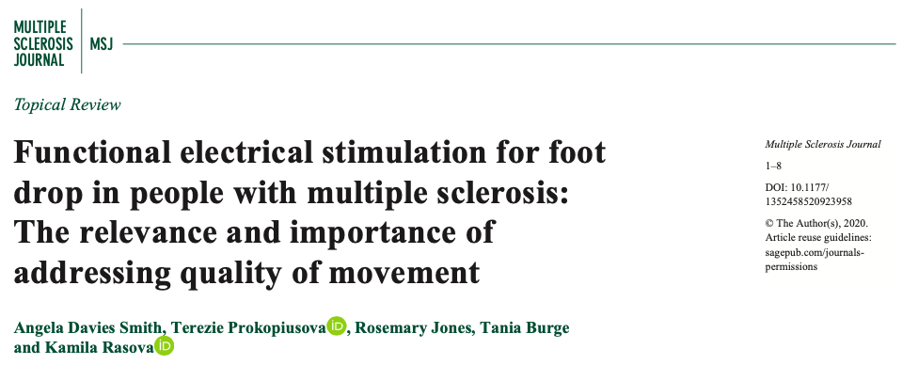

Video documenting an effect of therapy
Notes:
The video documents the qualitative effect of this concept.

Slide 18


Notes:
I systematically implement new scientific knowledge into my clinical work. For example, functional electrical stimulation can provide functional correction of foot drop by electrostimulation of the common peroneus nerve.

Slide 19
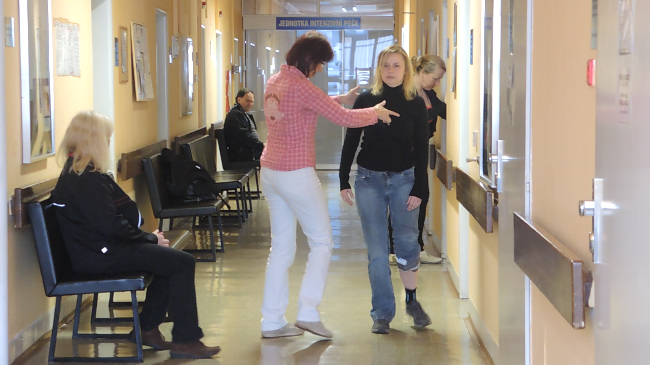
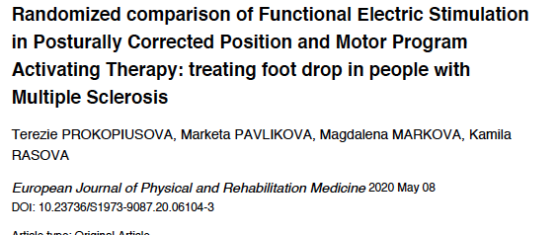
Funtional electrical stimulation in Posturally Corrected Position
Notes:
Its effectiveness increases by working with the postural system.

Slide 20
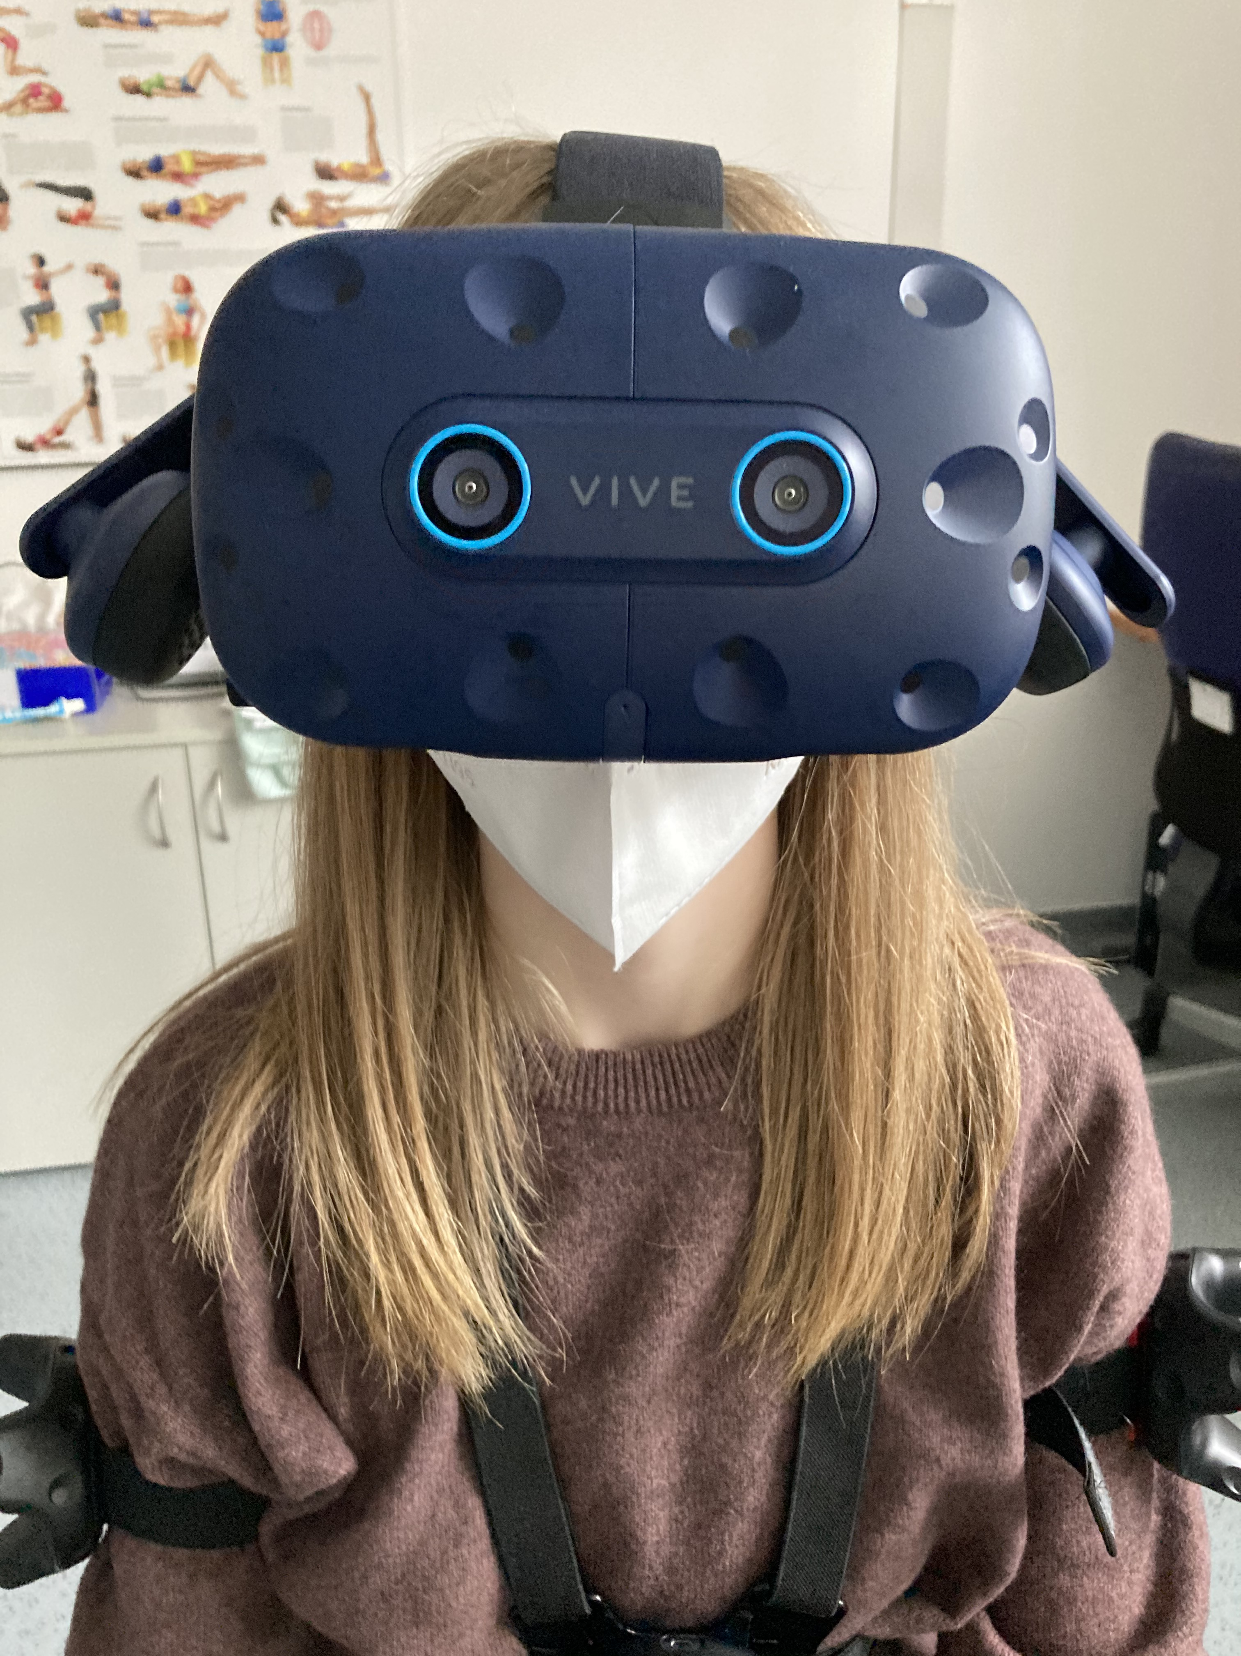
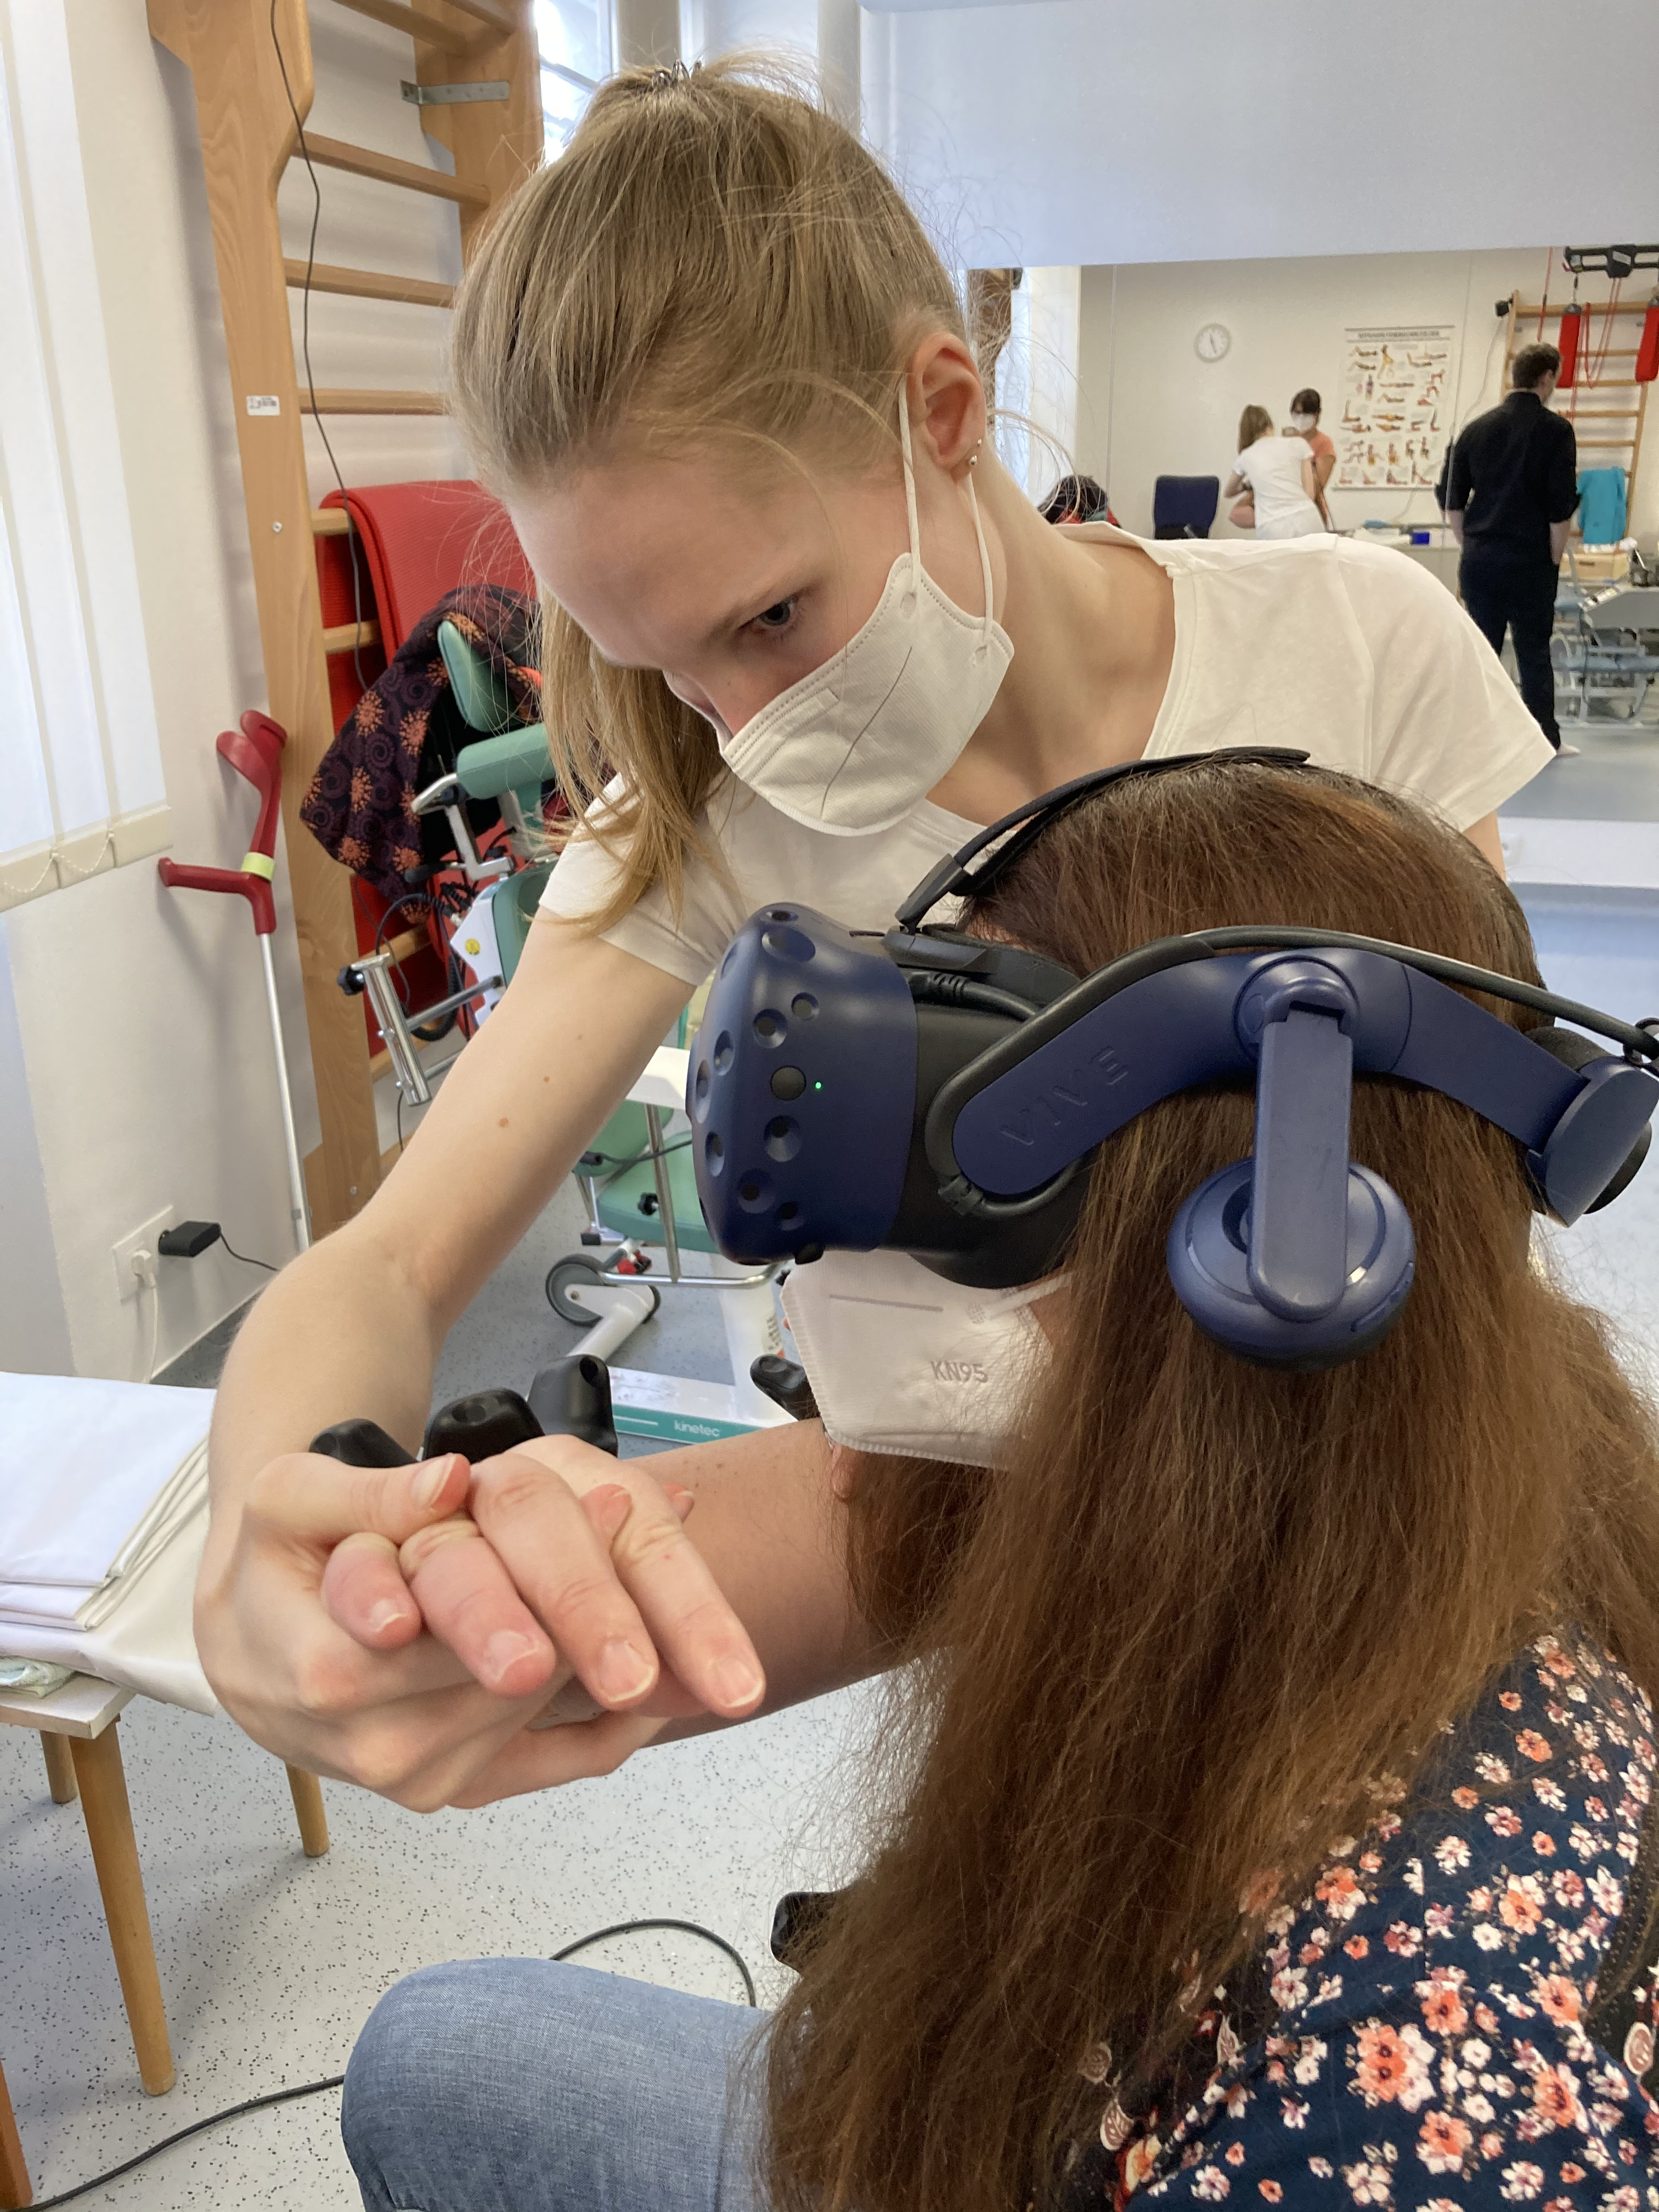
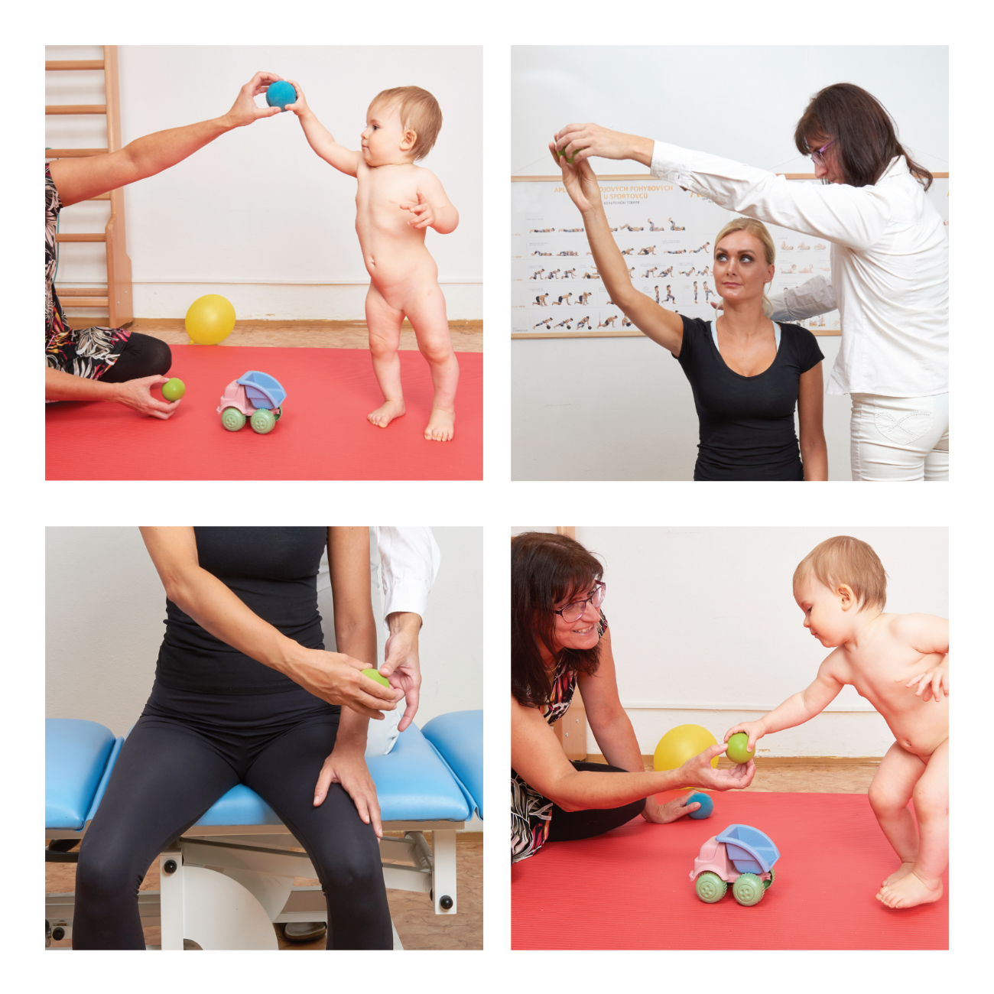
Combination of sensorimotor learning with neuroproprioceptive „facilitation, inhibition“
multifactorial sense stimulation
influences dopamine centres in the brain
influences mirror neurons
Notes:
Also, use of VR can increase the effectiveness of the therapy. In our approach, a specially programmed virtual environment guides the patient to perform high-quality movement, which is also facilitated by the therapist. At the same time, it motivates the patient to repeat the movement spontaneously.

Slide 21
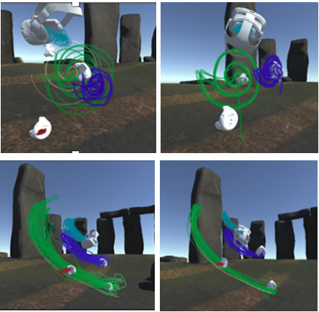
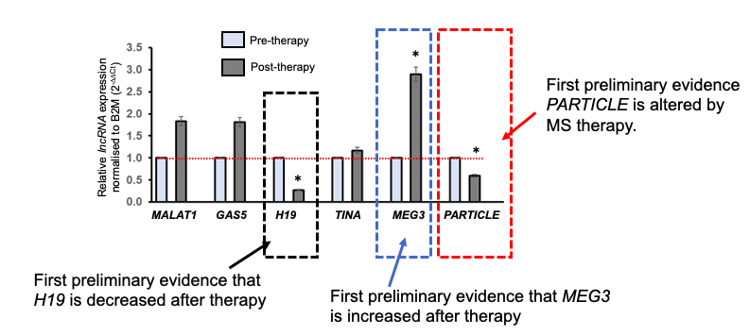
In memoriam with respect to Valerie B. O’Leary
Neuroproprioceptive “facilitation, inhibition” physical therapy in specially programmed virtual environment
improves the quality of the execution of the movement
has a potential to activate plastic and adaptive processes of the CNS in MS documented by upregulation of long non-coding RNA.
Notes:
Such an approach improves the quality of movement execution. Furthermore, our pilot project shows the potential to activate plastic and adaptive processes of the CNS in MS documented by the upregulation of a long non-coding RNA.

Slide 22

Plasticity and adaptability of the CNS
Axon
Neuron
Synapse
System organization
Notes:
The central nervous system is plastic and can adapt to changing conditions of the internal and external environment. As a result, adaptive changes may occur that contribute to functional recovery. These changes can occur spontaneously or can be supported by physiotherapy.

Slide 23
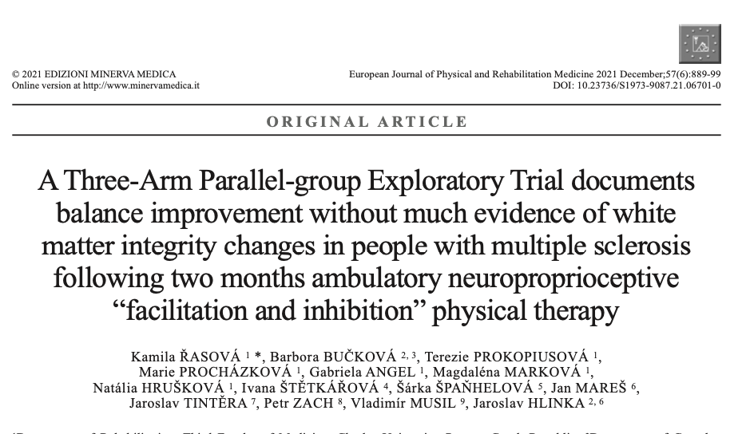
Neuroplasticity
Physical activity (fitness/endurance/resistance) training influences the CNS non-specifically – it induces new angiogenesis and increases cerebral blood flow without cortical reorganization, and it exerts a prophylactic influence on the cerebral atrophy observed earlier while preserving neuronal integrity.
Motor/skill acquisitions and Technology based PTs - systematically train damaged function. The repetition of new and complex movements induces a substantial cortical network reorganization topographically closely related to the trained movement that leads to a synaptogenesis process.
Neuropropriocptive ”facilitation, inhibition” PT suitable combines afferent stimuli, modulates interneuronal systems, repeatedly activates motor programs at the subcortical level, and as such induces adaptive and plastic processes of the CNS.
Notes:
All 4 categories of physiotherapy interventions have the potential to make plastic and adaptation processes.

Slide 24
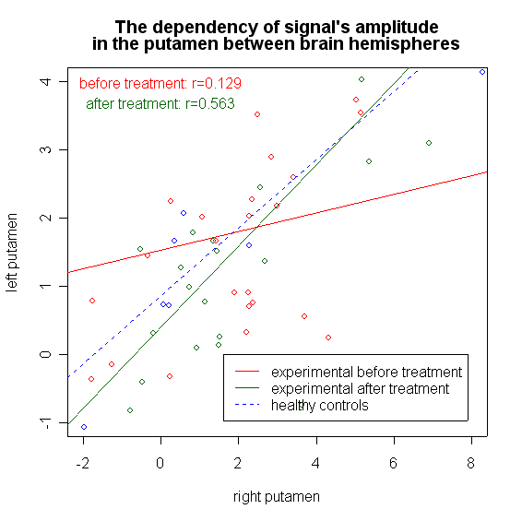
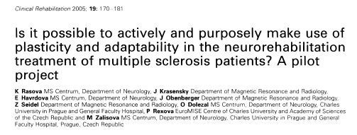
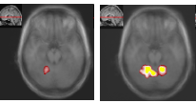
Plasticity and adaptability of the CNS – functional changes
Notes:
In our work, we monitored the adaptability and plasticity of the central nervous system in connection with neuroproprioceptive “facilitation, inhibition”. We confirmed functional changes in the CNS using functional magnetic resonance: an improvement in interhemispheric cooperation and an increment in activation in the cerebellum.

Slide 25
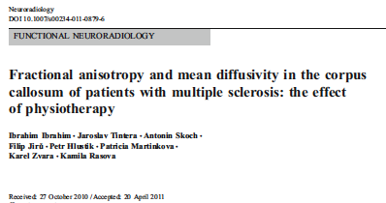



Plasticity and adaptability of the CNS – structural changes
Reduction of radial diffusivity – remyelination
Increasing fractional anisotropy – improving white matter integrity
Notes:
In another work, structural changes in the brain using tractography were documented. After two months of ambulatory neuroproprioceptive “facilitation, inhibition” was shown that there is a decrement of radial diffusivity (remyelination?) and an increment of fractional anisotropy (improvement of white matter integrity?).

Slide 26


Thank you for your attention!
iBook: https://itunes.apple.com/cz/book/neurorehabilitation-people-impaired-mobility-therapeutic/id1207772832
https://www.ceros.mobi/pro-odborniky/odborne-akce
Notes:
If you are more interested in the issue of neurorehabilitation, look at the book, which is freely available on the website. I also thank for organizing the conference. Presentations from today, as well as from the entire workshop, can be found on the website. Thank you for your attention!

