Slide 1

Aging and Neurological Diseases - Needs for Rehabilitation
Marja Äijö, PhD, Physiotherapist
Principal lecturer of gerontology and rehabilitation, Savonia –UAS, Kuopio, Finland
16.5.2024 Conference: Possibilities for Rehabilitation in people with neurological Health Condition

Slide 2

Content
Aging as a global phenomenon
Aging and functional ability
The needs for neurological rehabilitation

Slide 3

Life expectancy
Marja Äijö, PhD, Physiotherapist
Principal lecturer of gerontology and rehabilitation, Savonia –UAS, Kuopio, Finland

Slide 4
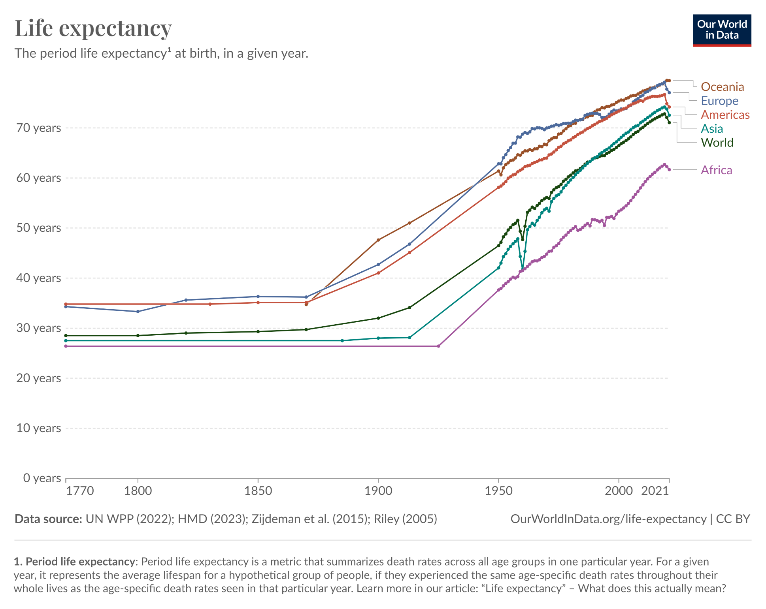

Slide 5
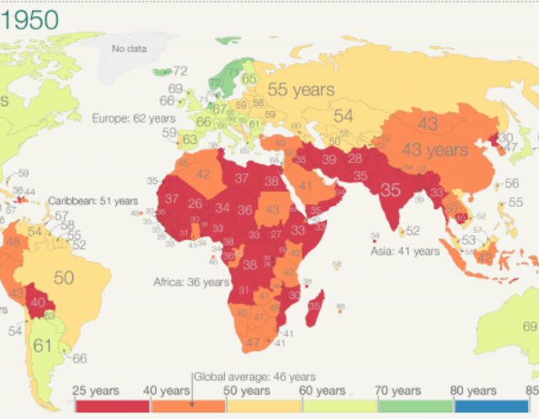
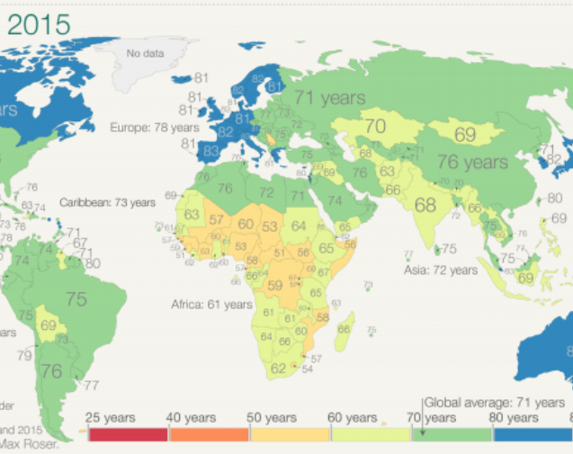
Global perspective: Life expectancy in a year 1950 and 2015
(Max Roser (2018) - “Twice as long – life expectancy around the world”
Published online at OurWorldInData.org. Retrieved from:
'https://ourworldindata.org/life-expectancy-globally' [Online Resource])

Slide 6
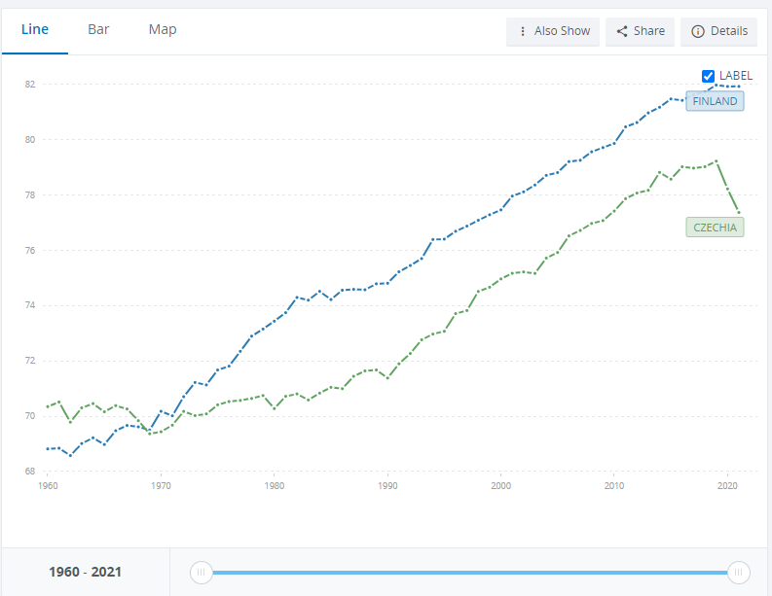
Life expectancy at birth, total (years) - Finland, Czechia
Finland: 82 yeas
Czechia: 77 years
In a year 2021

Slide 7
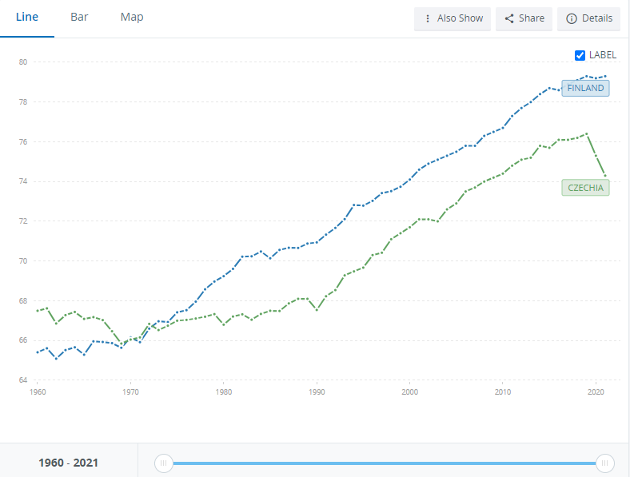
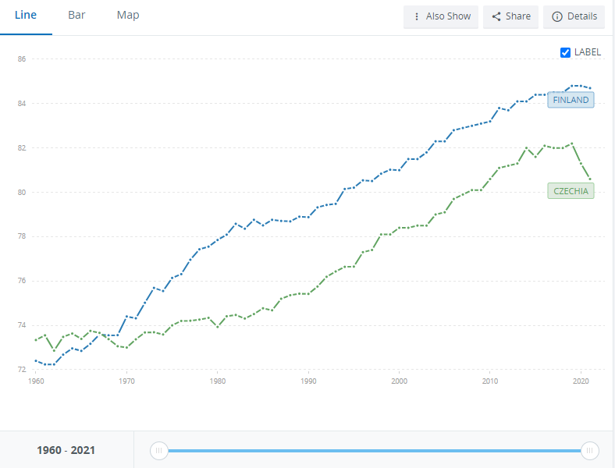
Life expectancy at birth, male (years) - Finland, Czechia
Life expectancy at birth, female (years) - Finland, Czechia

Slide 8

World population aging
Marja Äijö, PhD, Physiotherapist
Principal lecturer of gerontology and rehabilitation, Savonia –UAS, Kuopio, Finland

Slide 9
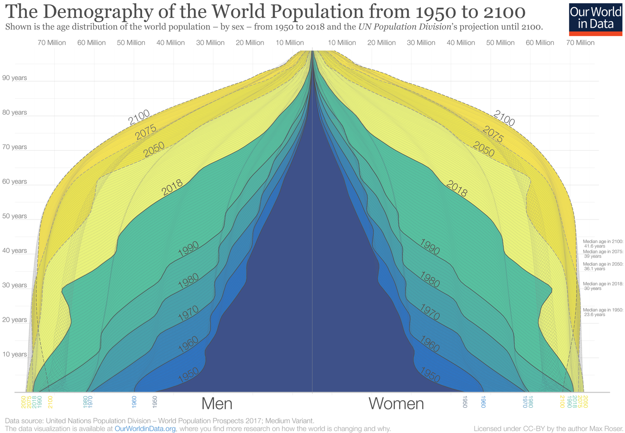
(https://ourworldindata.org/global-population-pyramid )

Slide 10
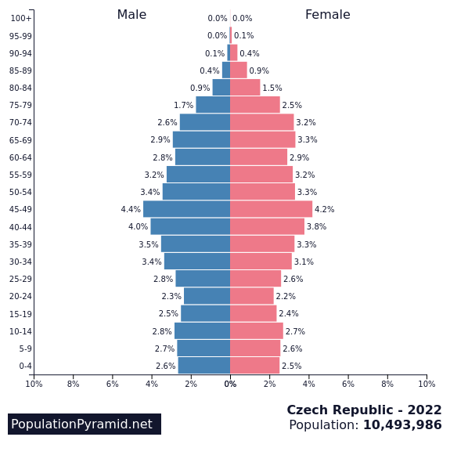
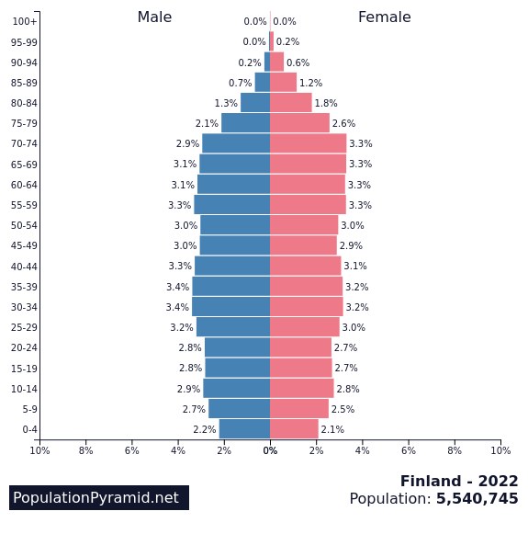
Age pyramids
http://tilastokoulu.stat.fi/verkkokoulu_v2.xql?page_type=esim&course_id=tkoulu_tlkt&lesson_id=6&subject_id=5&example_id=2
https://www.stat.fi/tup/suoluk/suoluk_vaesto_en.html#Population%20structure%20on%2031%20December
(https://www.populationpyramid.net/czech-republic/2022/ & https://www.populationpyramid.net/finland/2022/ )

Slide 11
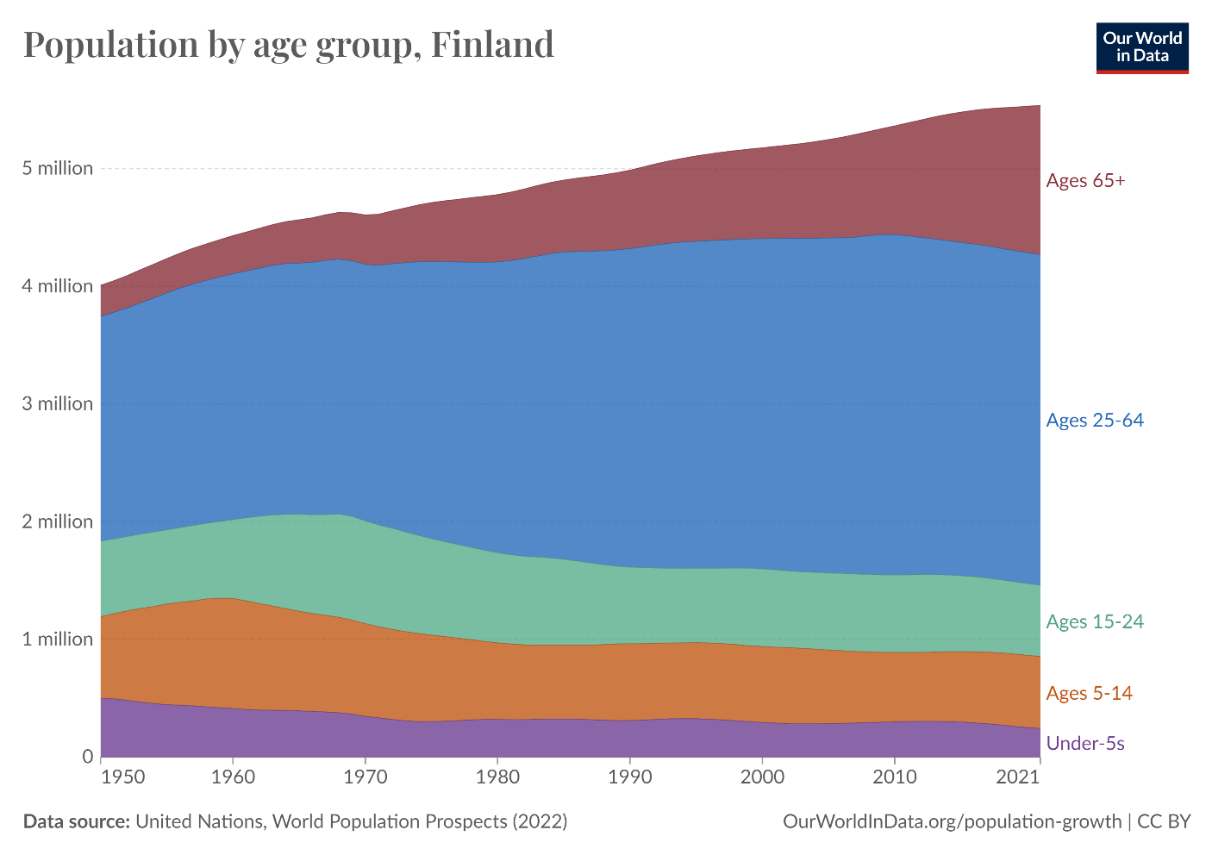
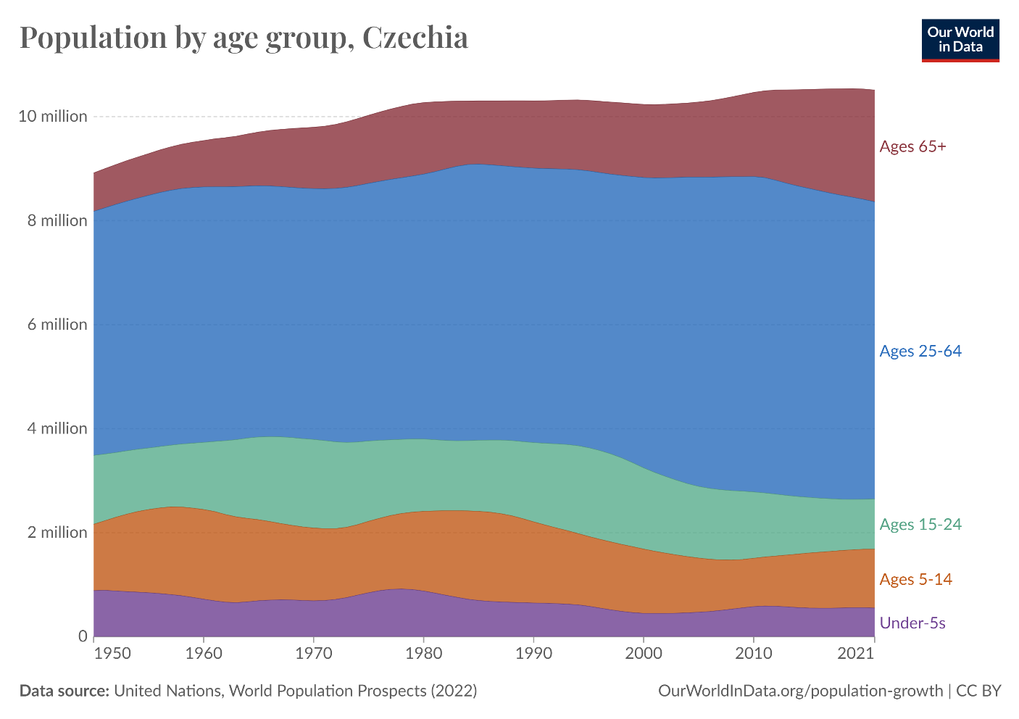
(https://ourworldindata.org/age-structure )

Slide 12
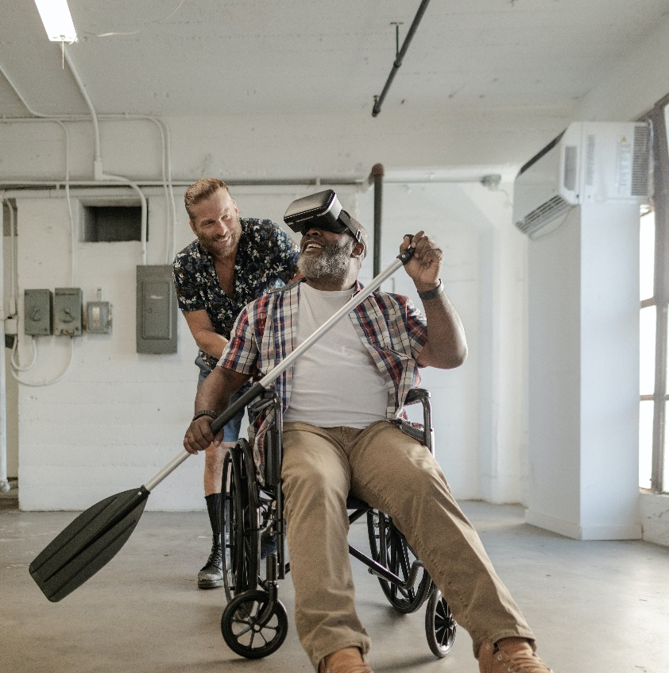
Aging, functional ability and neurological disorders
Marja Äijö, PhD, Physiotherapist
Principal lecturer of gerontology and rehabilitation, Savonia –UAS, Kuopio, Finland

Slide 13
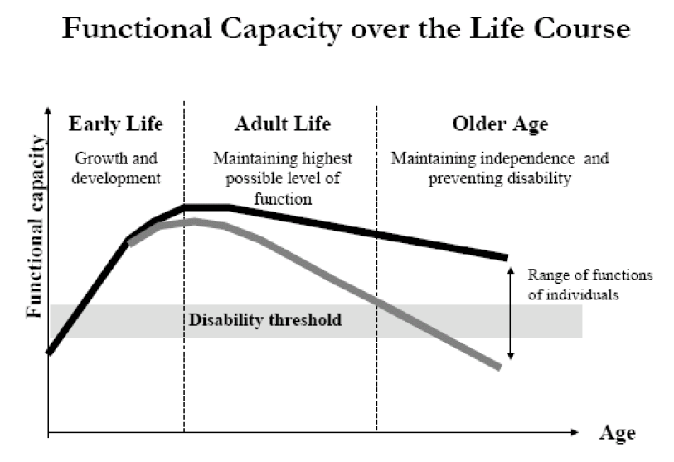
(World Health Organisation, Ageing and Life Course Programme, 2000, activeageing@who.int)

Slide 14
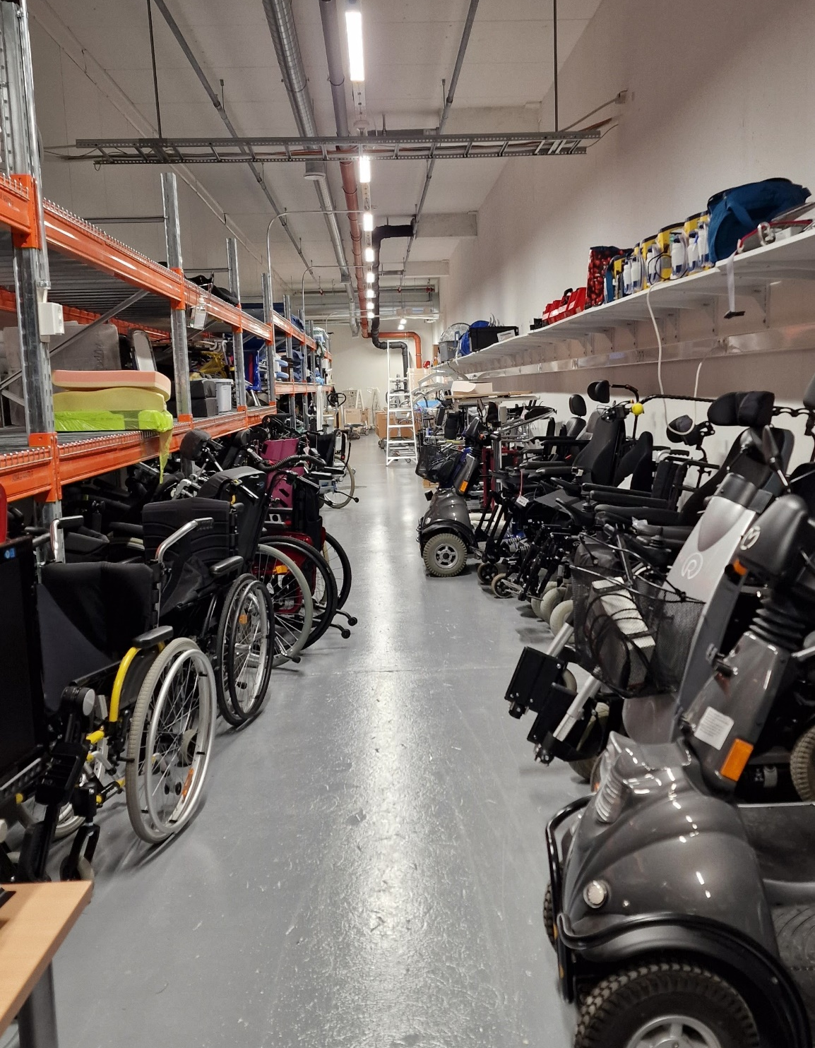
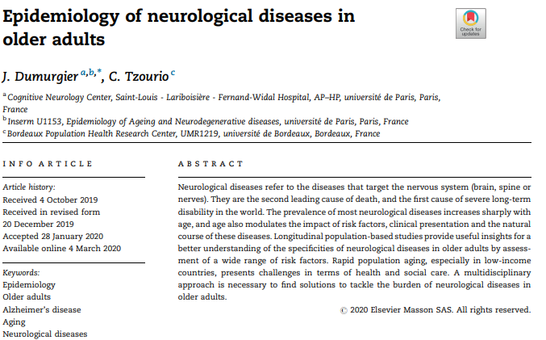
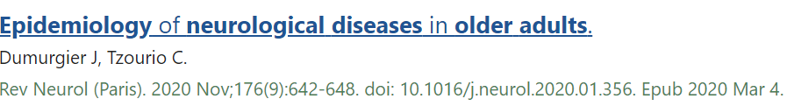

Slide 15
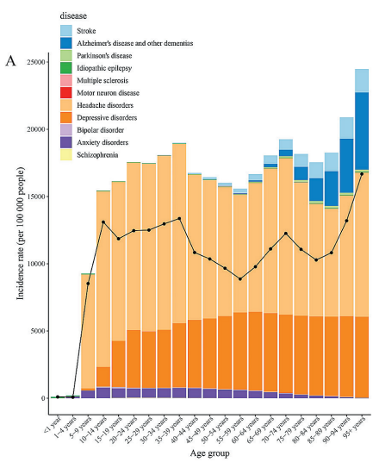
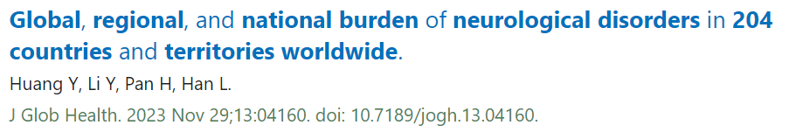
The incidence of neurological disorders and its main subtypes among different age groups.

Slide 16
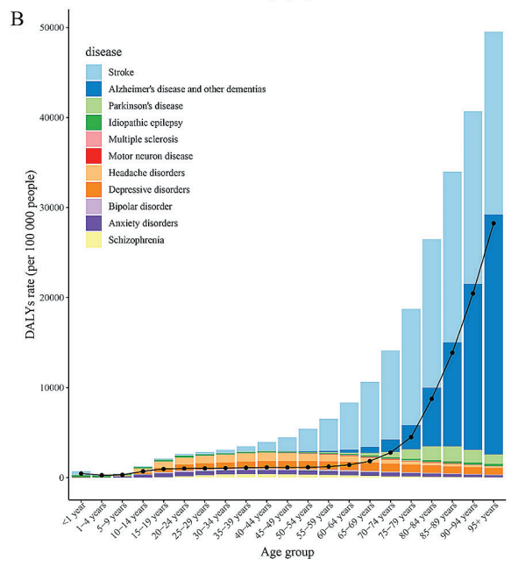
DALY rates of neurological disorders and its main subtypes among different age groups.
DALYs=disability-adjusted life-years

Slide 17
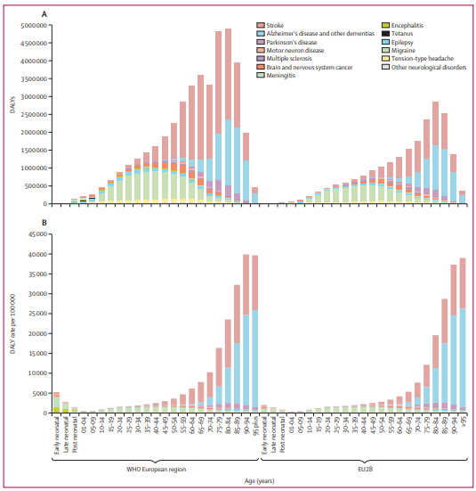
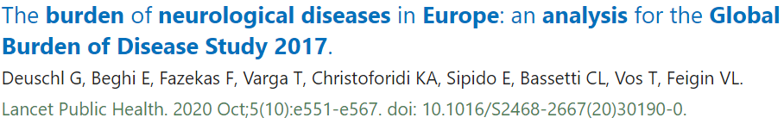
EU28 and WHO European region DALYs
Total number of DALYs (A) and
age-standardised DALY rates
(B) by age group including both sexes in 2017.
DALYs=disability-adjusted life-years.
EU28=the 27 countries in the EU plus the UK

Slide 18
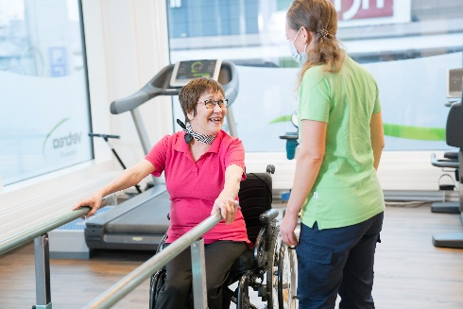
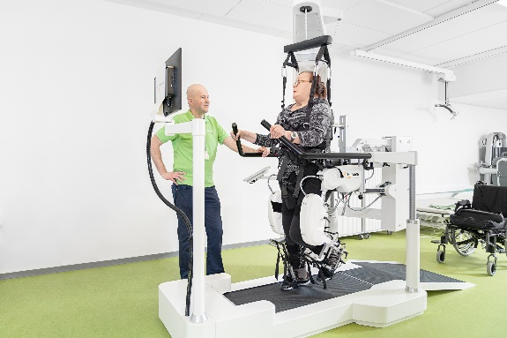
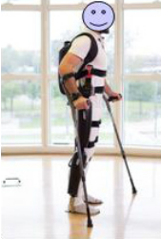
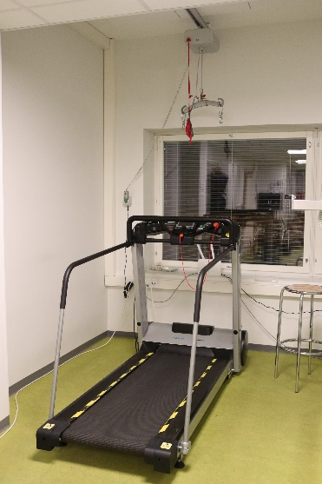
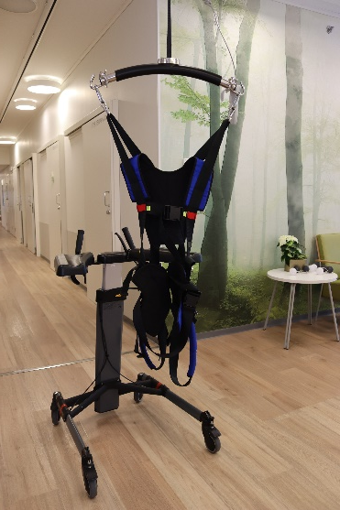
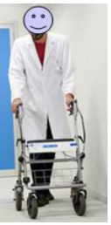
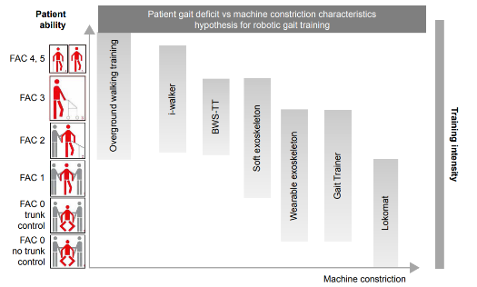
1. Robot-assisted
for example
Gait Trainer GT I
2. Wearable device
-For example, Lokomat and exoskeleton
5. Assisted training
for example rollator or walking stick
3. Weighted walking/
-treadmill training
4. Weighted gait training on a harness wheel
(Morone et al. 2017. Robot-assisted gait training for stroke patients:
current state of the art and perspectives of robotics.
Neuropsychiatric Disease and Treatment 13 1303–1311.)

Slide 19
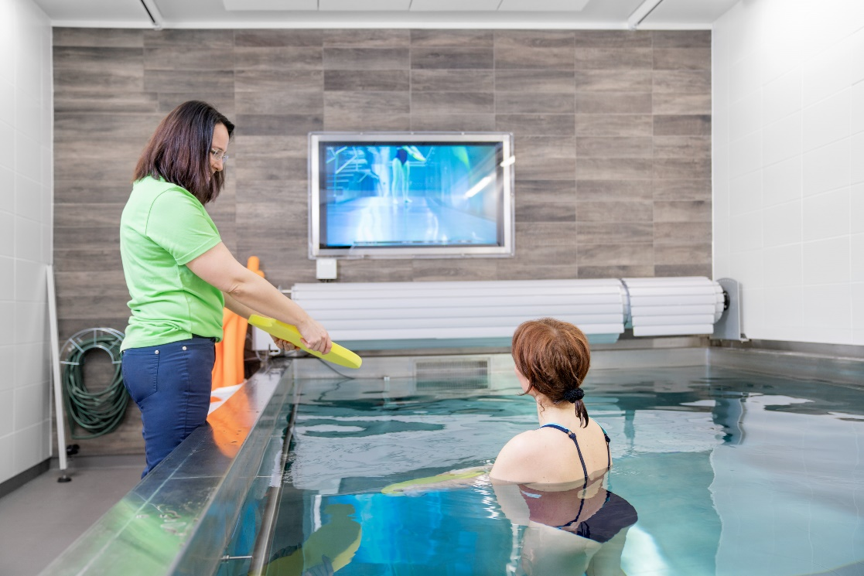
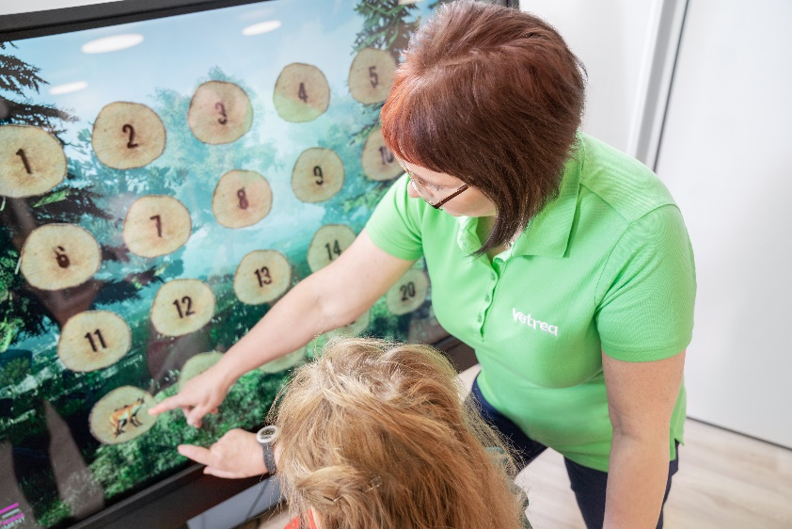
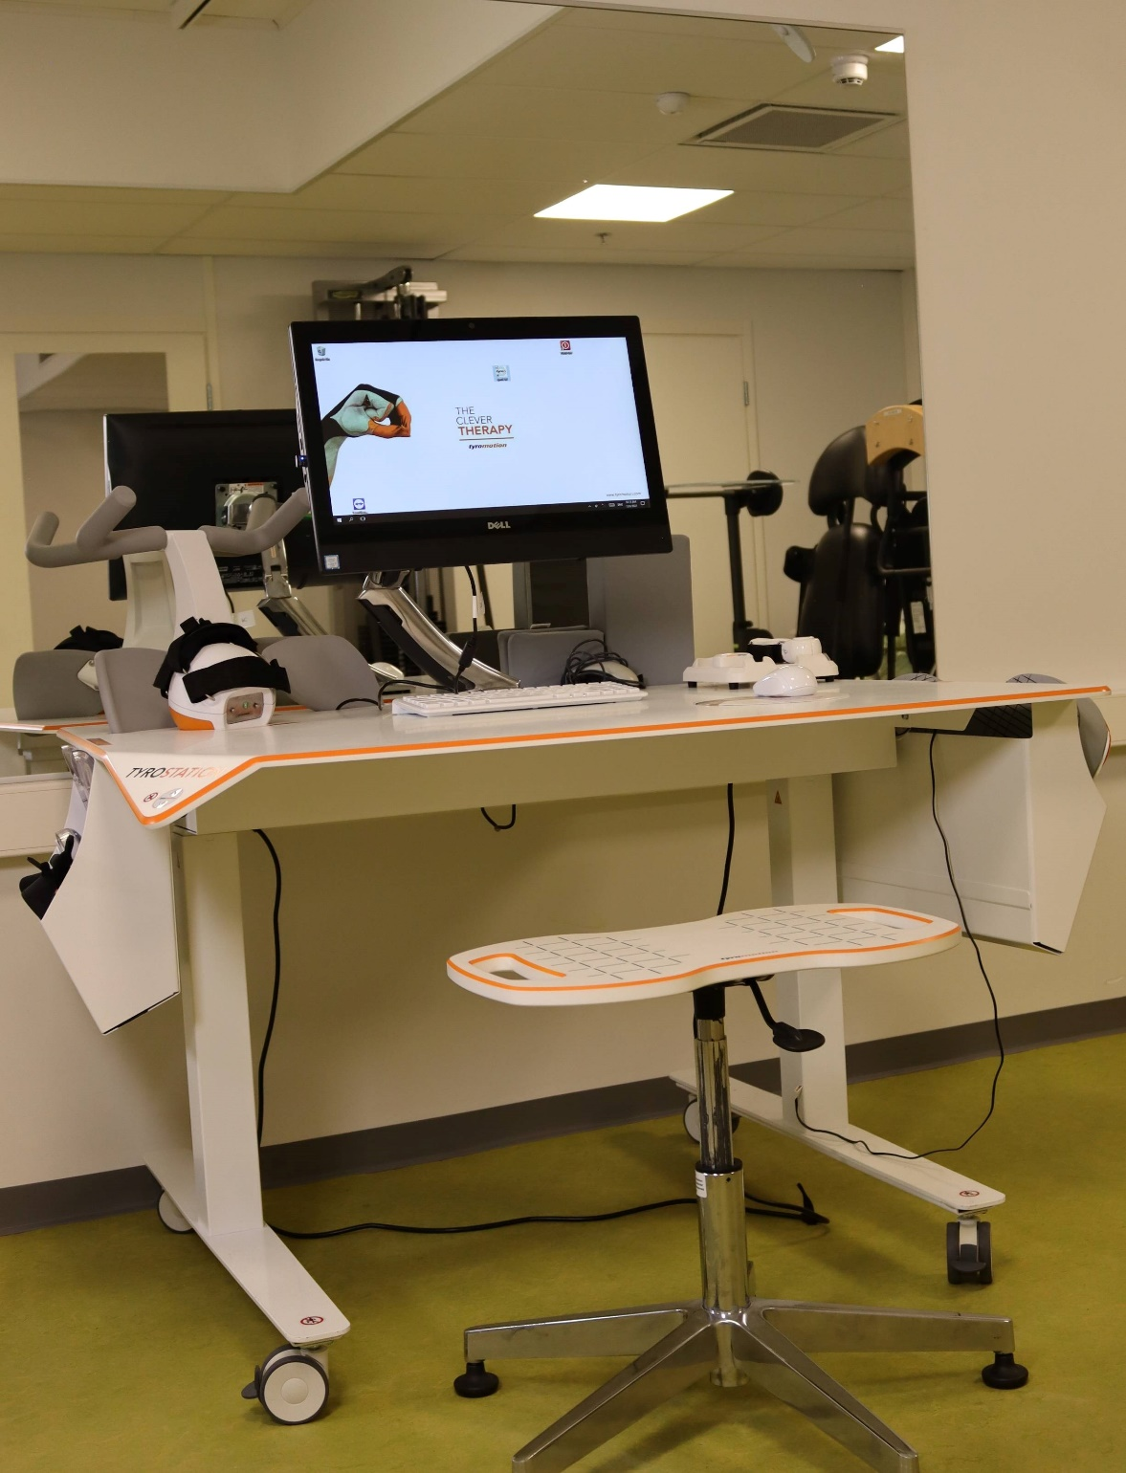
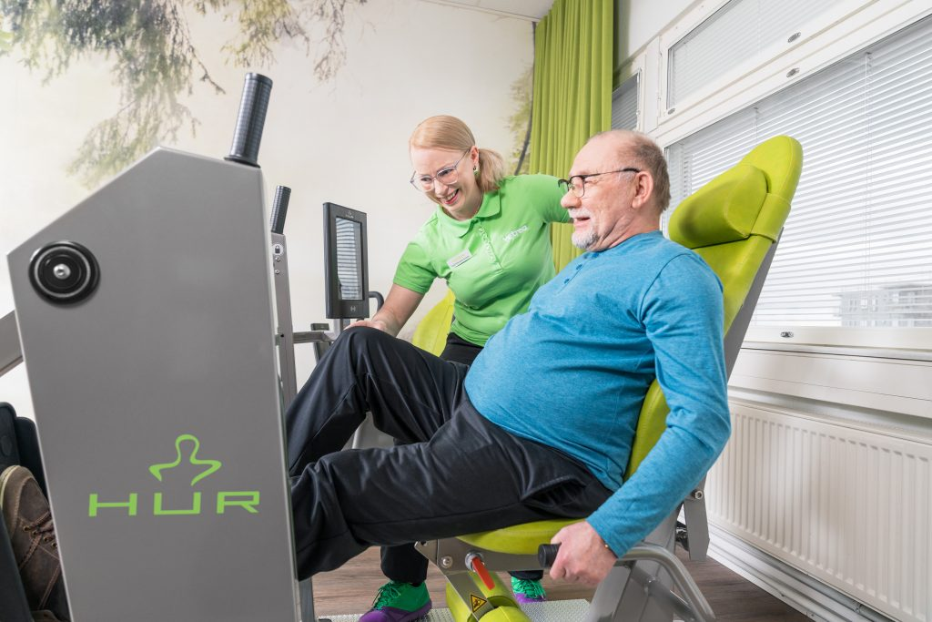
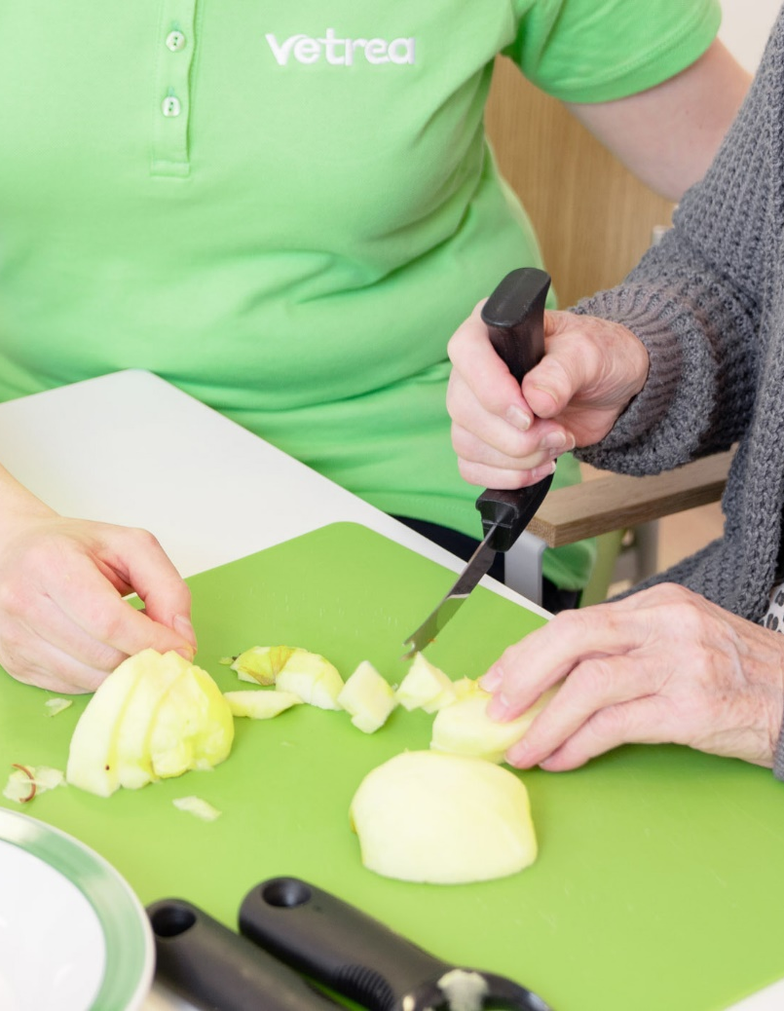
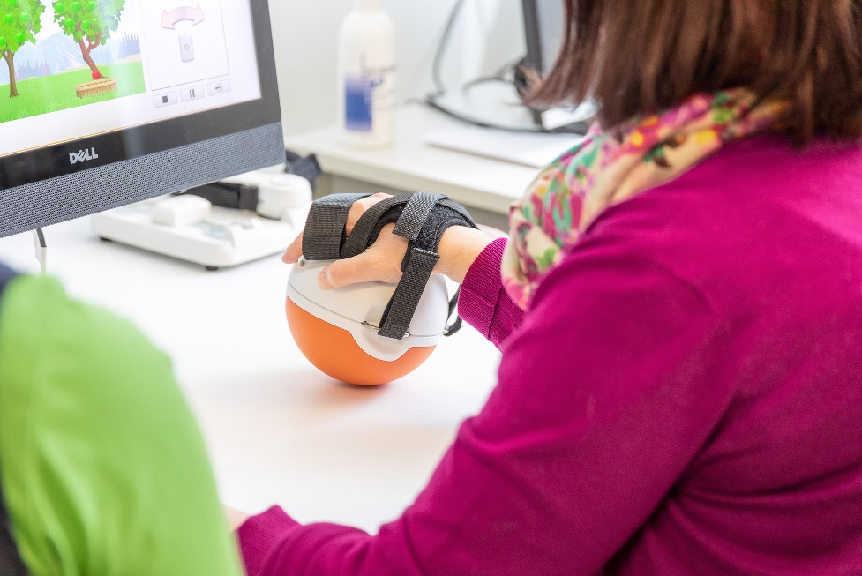

Slide 20
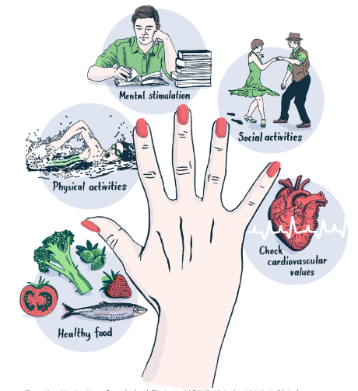
LIFESTYLE MEASURES FOR prevention of cognitive decline
The FINGER model is based on scientific evidence from the FINGER study, showing that simultaneous lifestyle measures in five areas can help prevent and delay the development of cognitive decline.
(https://fbhi.se/the-finger-model/)

Slide 21

Summery
The ageing population
Life expectancy has increased, but ….
Among older adults' neurological disorders are common and they live longer with disorders
Rest of the life-long process
There is a need of rehabilitation among older adults living with neurological disorders

Slide 22



Marja Äijö PhD
Principal Lecturer of gerontology and rehabilitation Savonia University of Applied Sciences
Unit of Health Care Kuopio
P.O. Box 6
FIN-70111 Kuopio
Finland
tel +358 44 785 6425
fax +358 17 255 6422
@MarjaAijo
Marja Äijö
e-mail: marja.aijo@savonia.fi

